Slide 1
Project Logbook Plots
Tom Tyler
Supervisor: James Brind
IIB Project
Open-source Data-driven Aerodynamic Turbine Design
(This logbook has a complimentary physical book)

Slide 2
Week 1 M
Getting to grips with Gaussian Process Regression

Slide 3
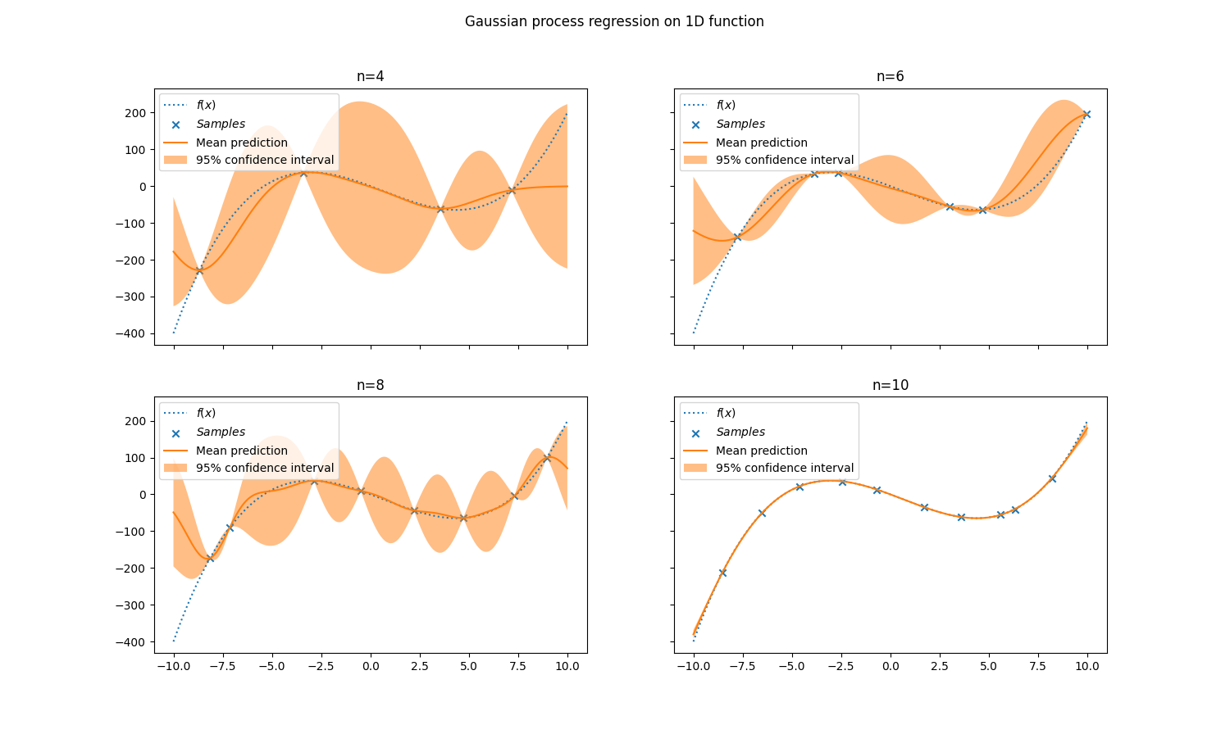
Fitting 1D Data - varying n

Slide 4
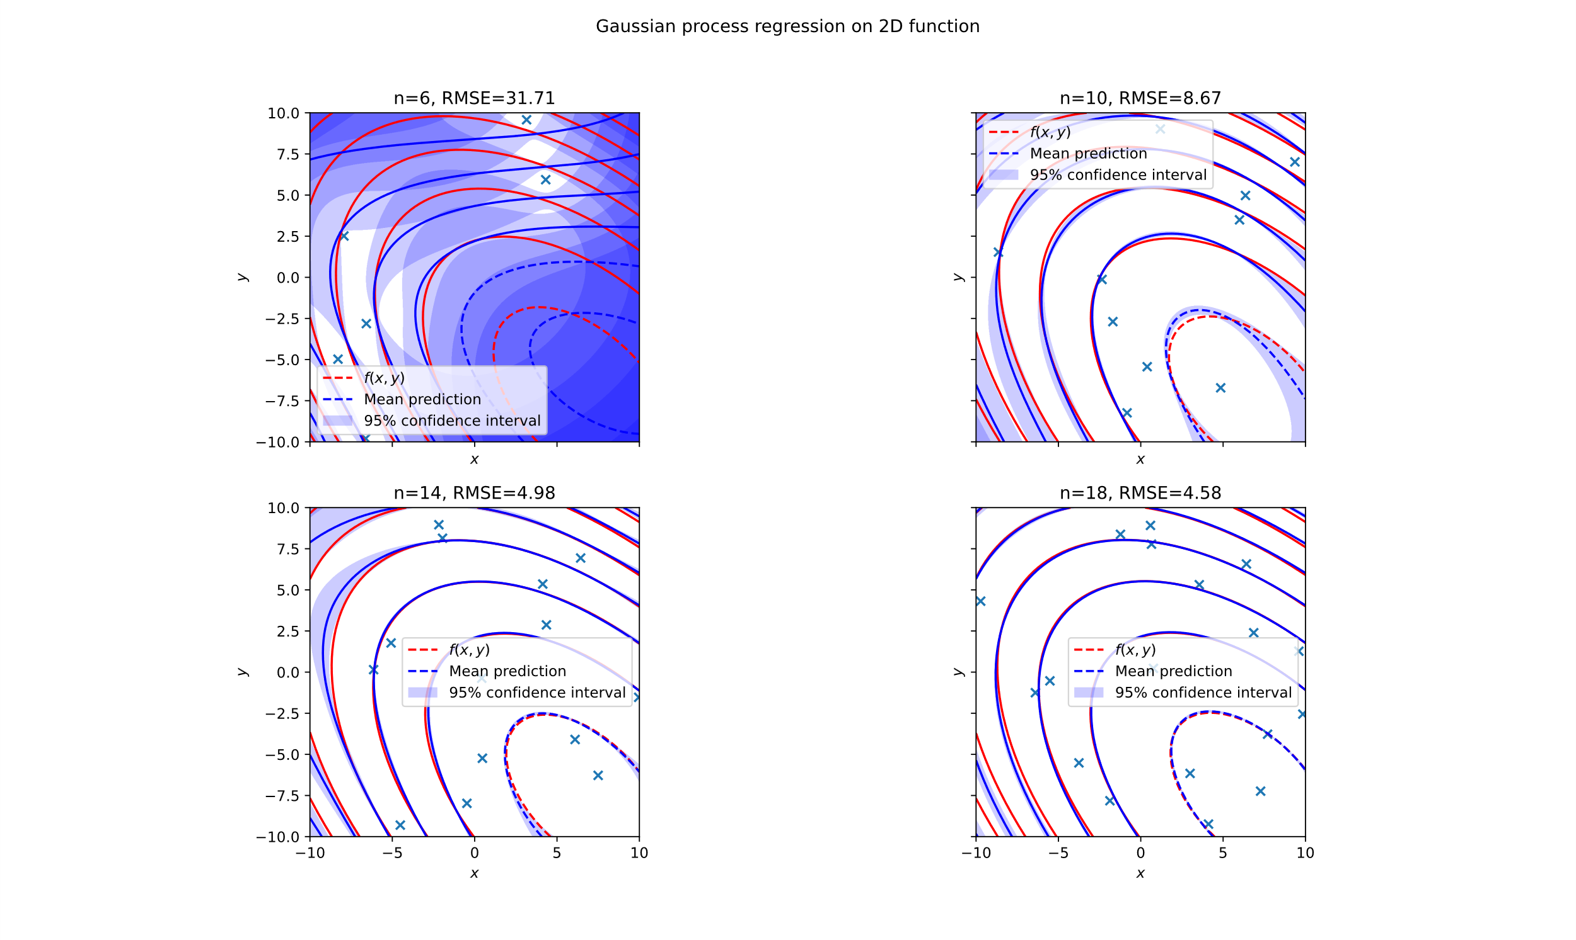
Fitting 2D Data - varying n

Slide 5
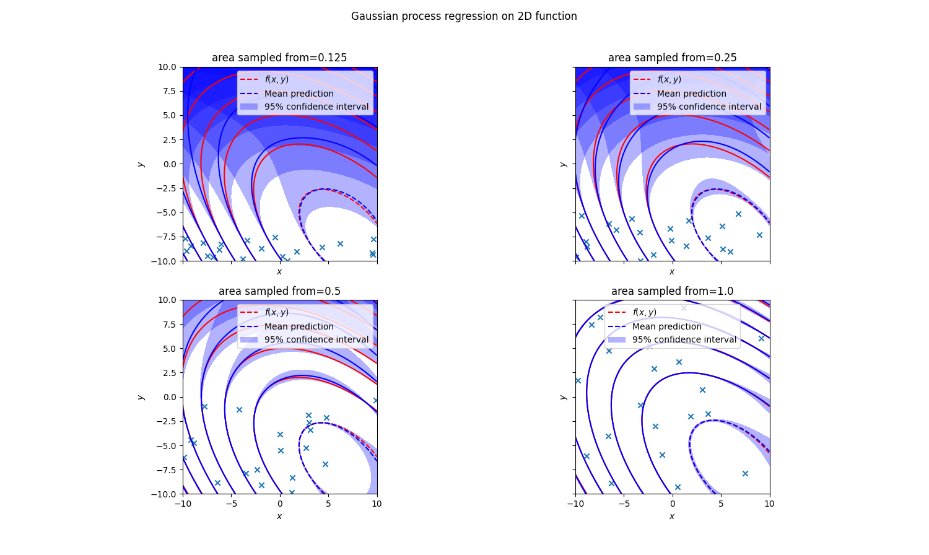
Fitting 2D data – vary space sampled from

Slide 6
Week 2 M
Development of turbine design tool using GPR

Slide 7
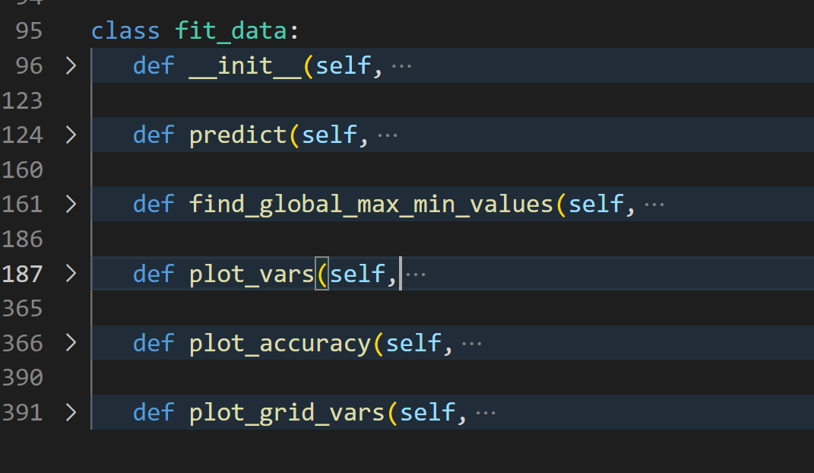
General code layout

Slide 8
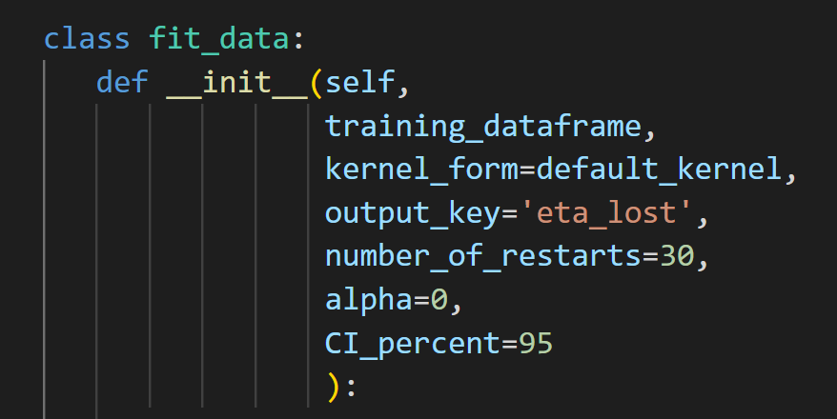
fit_data – create model

Slide 9
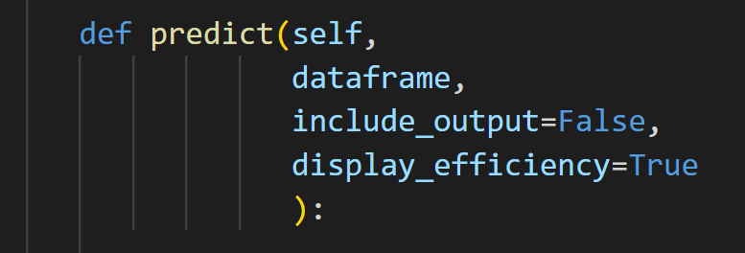
predict

Slide 10
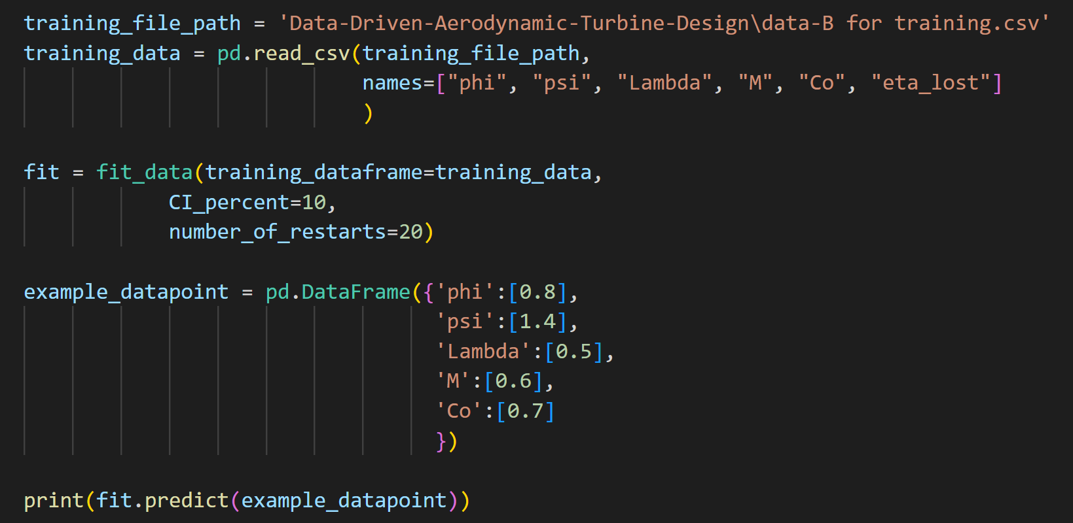
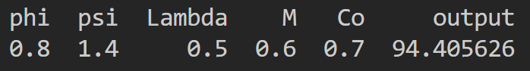
predict (example)

Slide 11
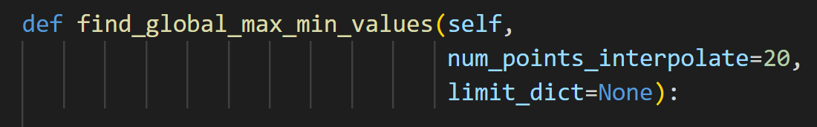
find_global_max_min_values
Number is small, as needs to find maximum value out of n⁵ data points. How can this be improved? Gradient descent? With 20, method takes 26 seconds (in debug mode)

Slide 12
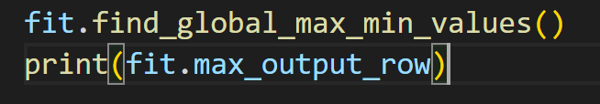
find_global_max_min_values (example)
Finds the maximum value without extrapolation

Slide 13
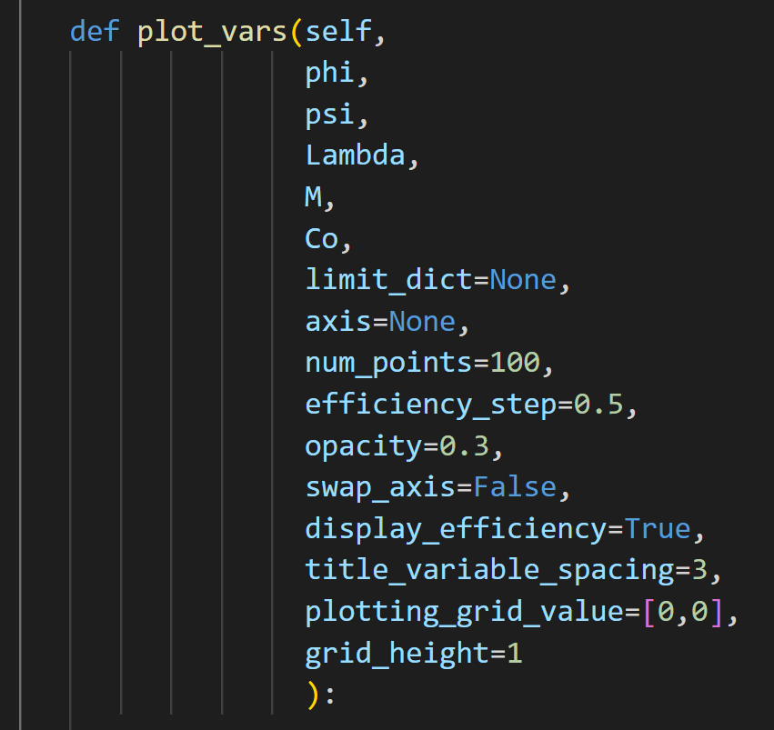
plot_vars

Slide 14
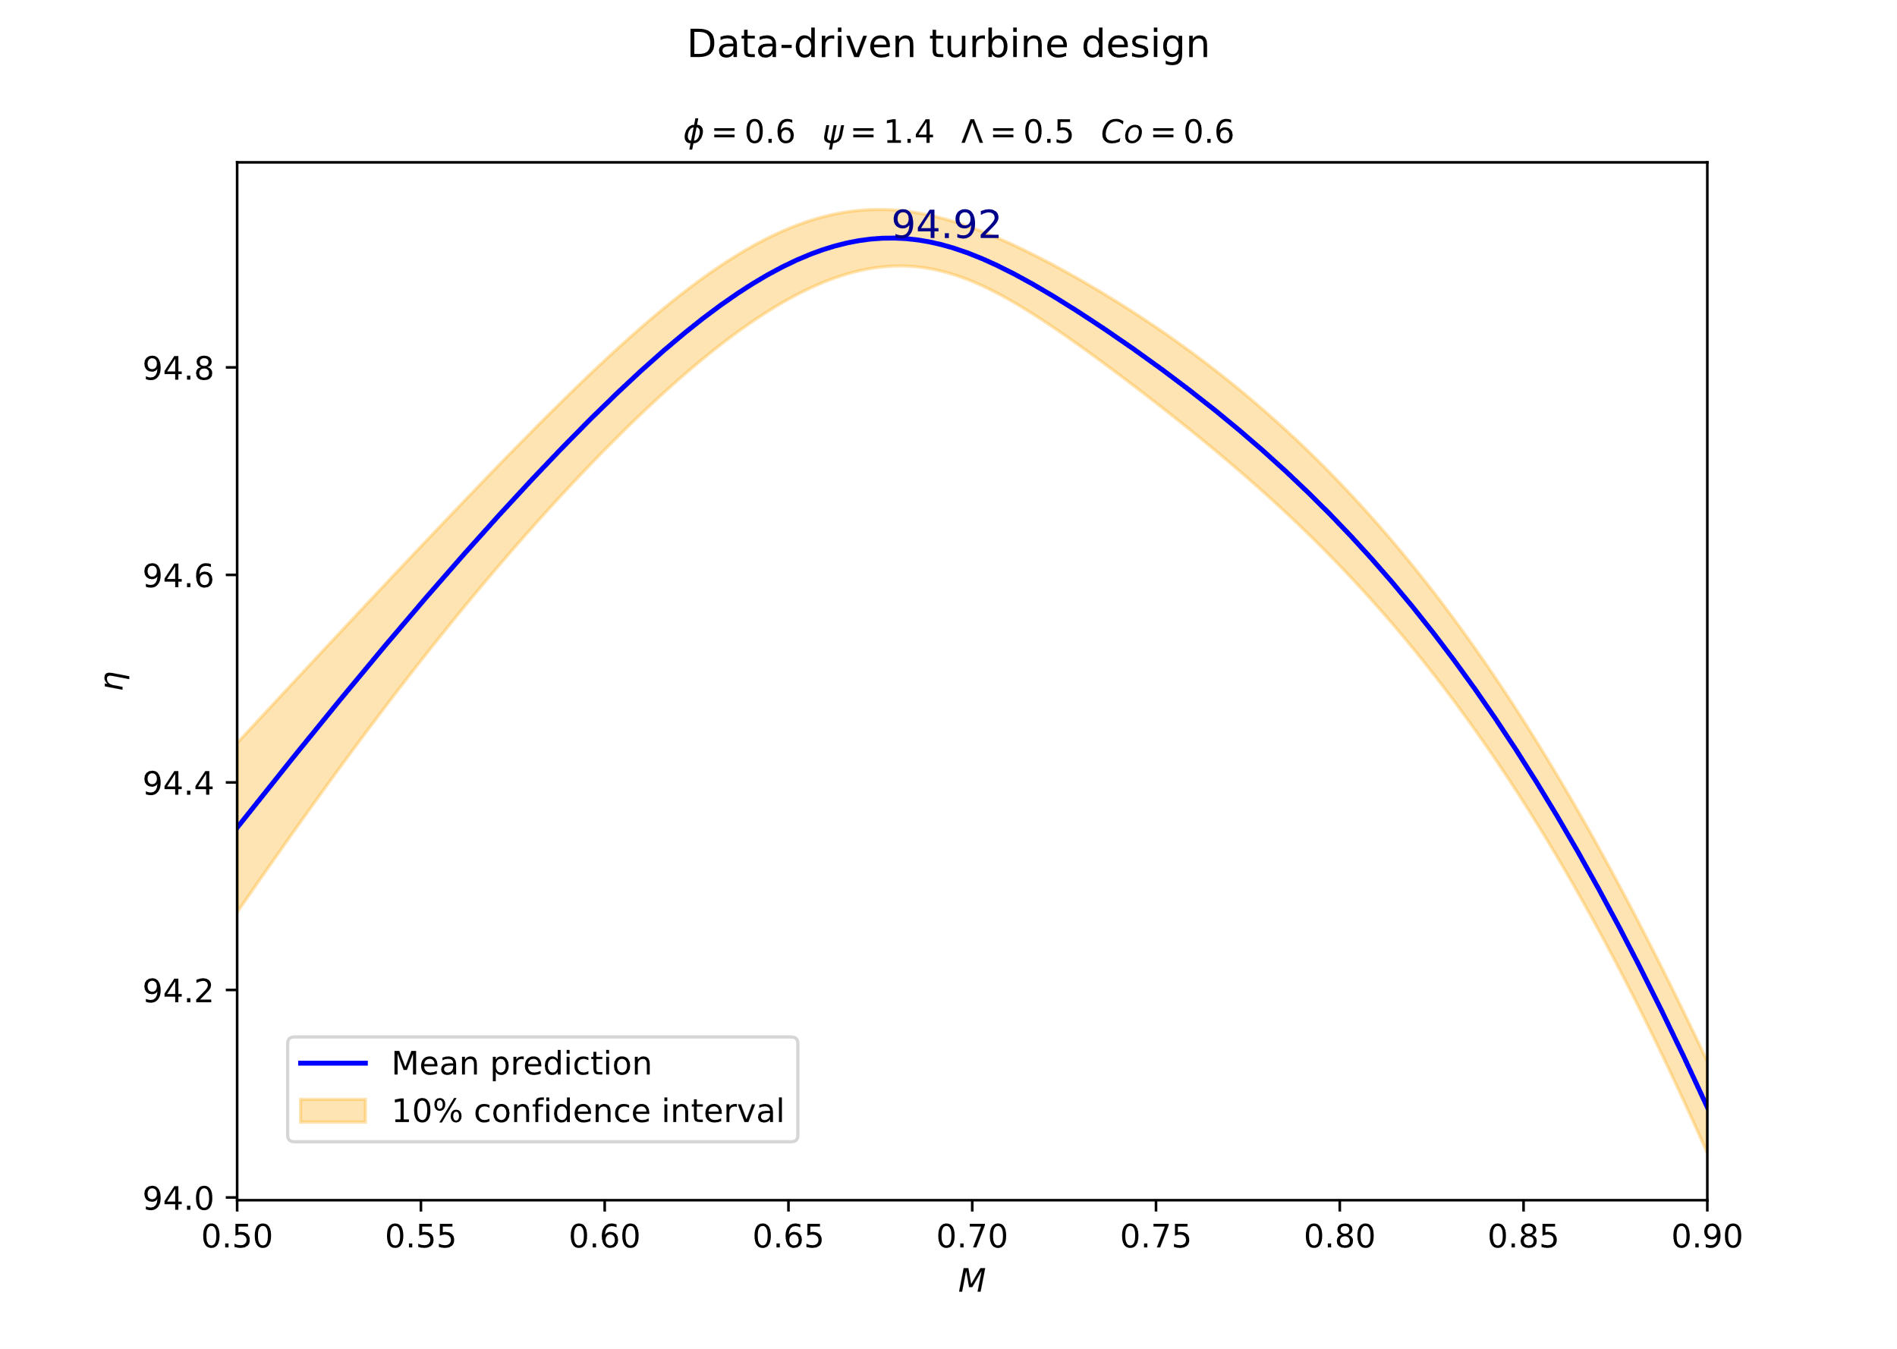
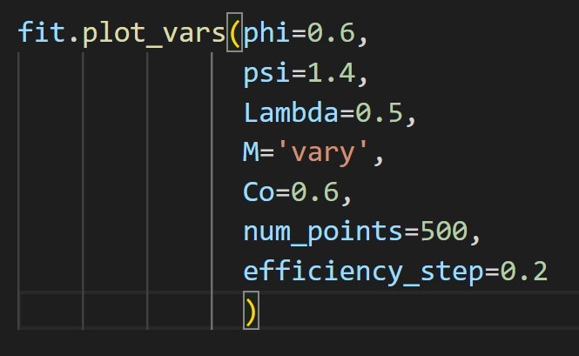
plot_vars (examples)

Slide 15
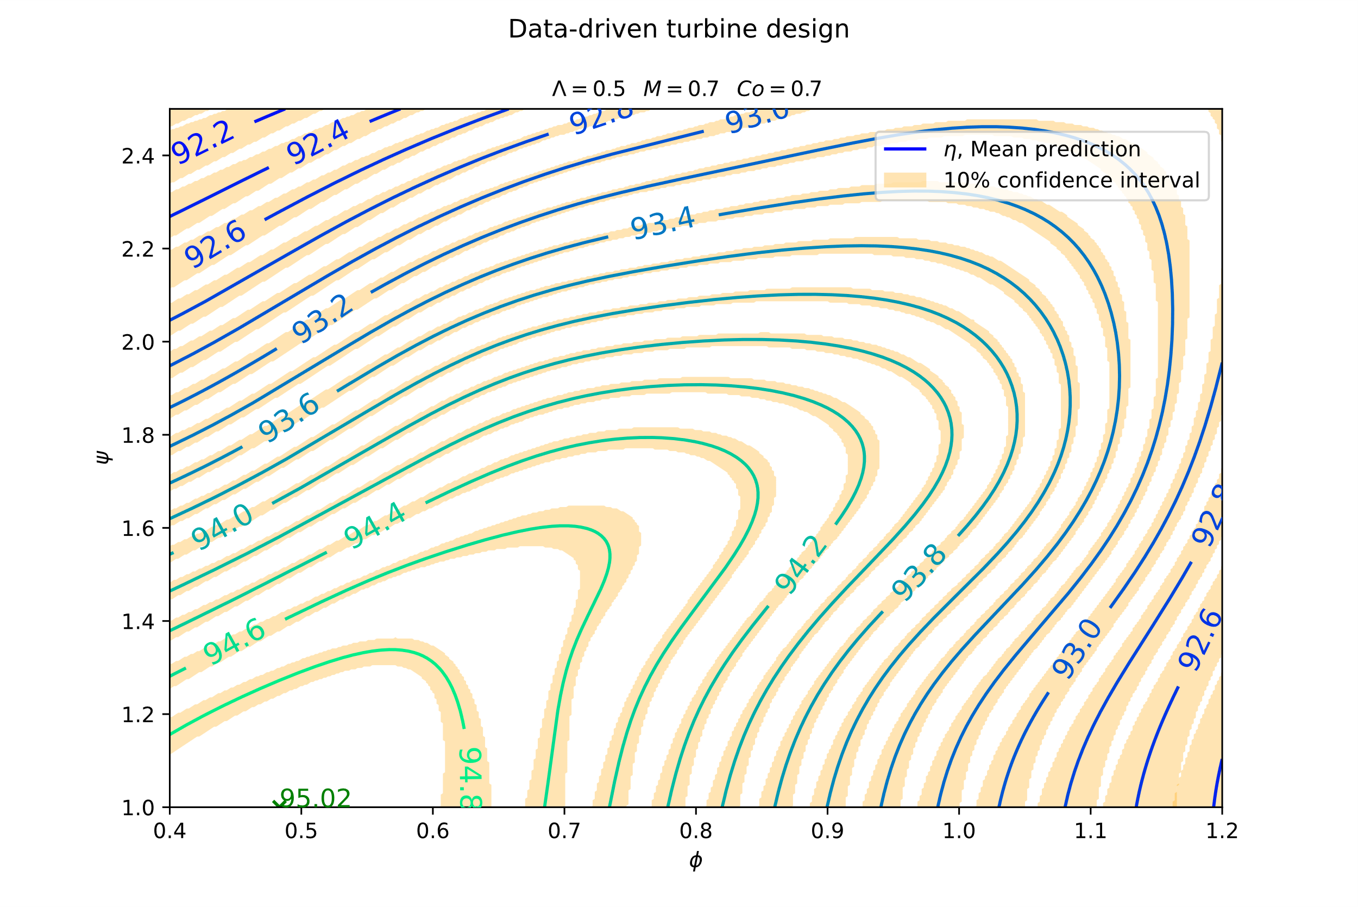
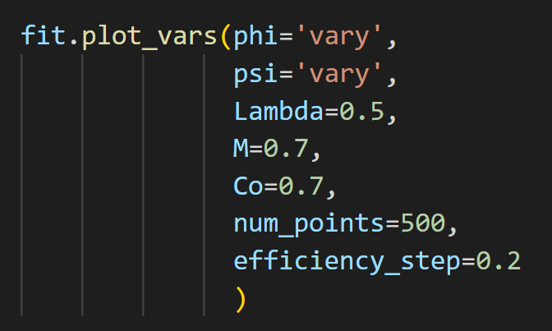
plot_vars (examples)

Slide 16
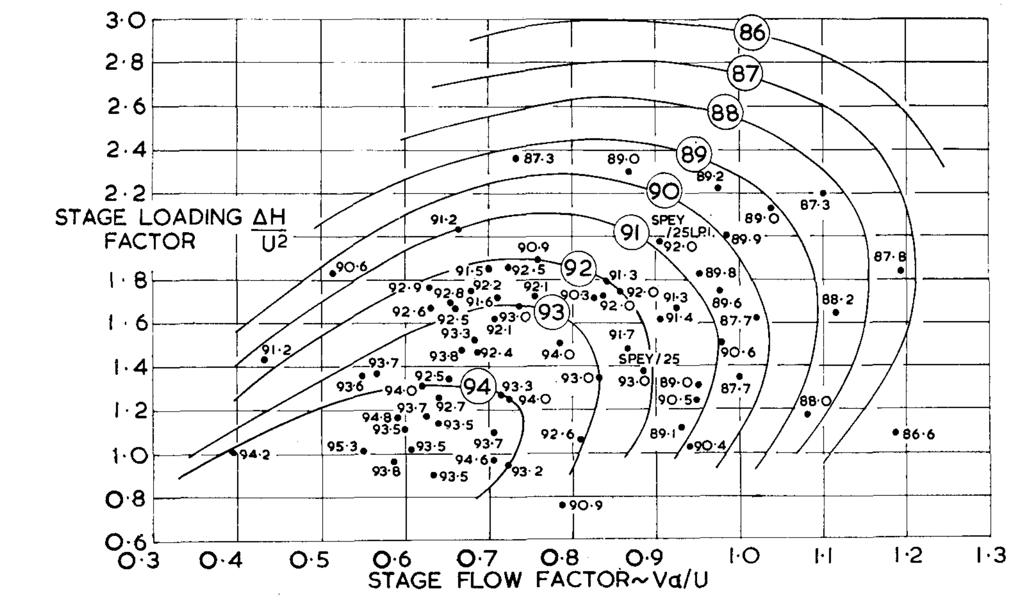
plot_vars (smith chart comparison)
Different axis
Do not know values of Co and M

Slide 17
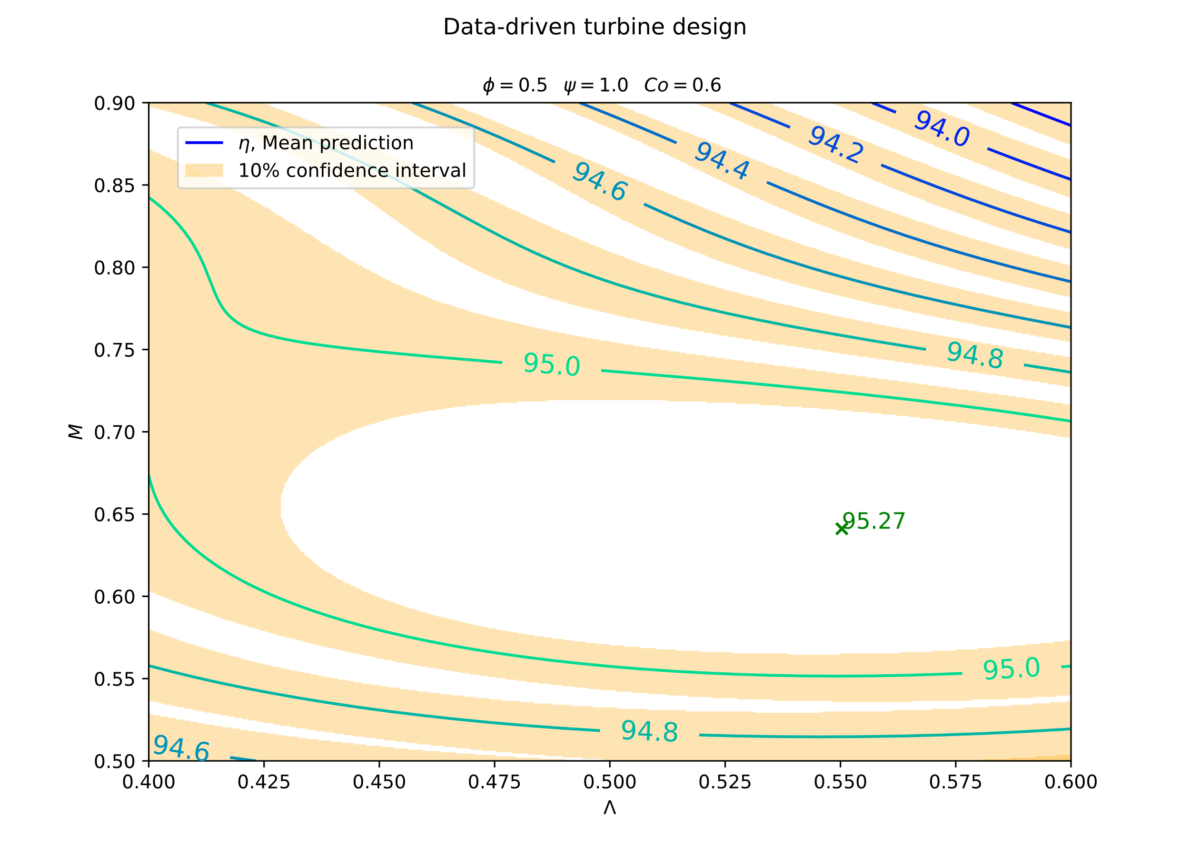
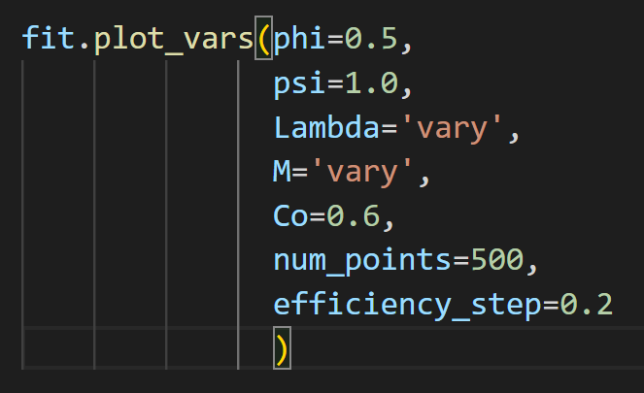
plot_vars (examples)

Slide 18
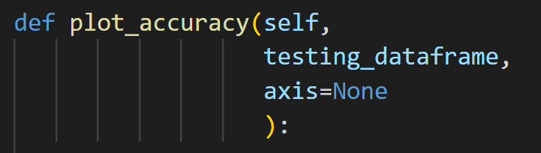
plot_accuracy

Slide 19
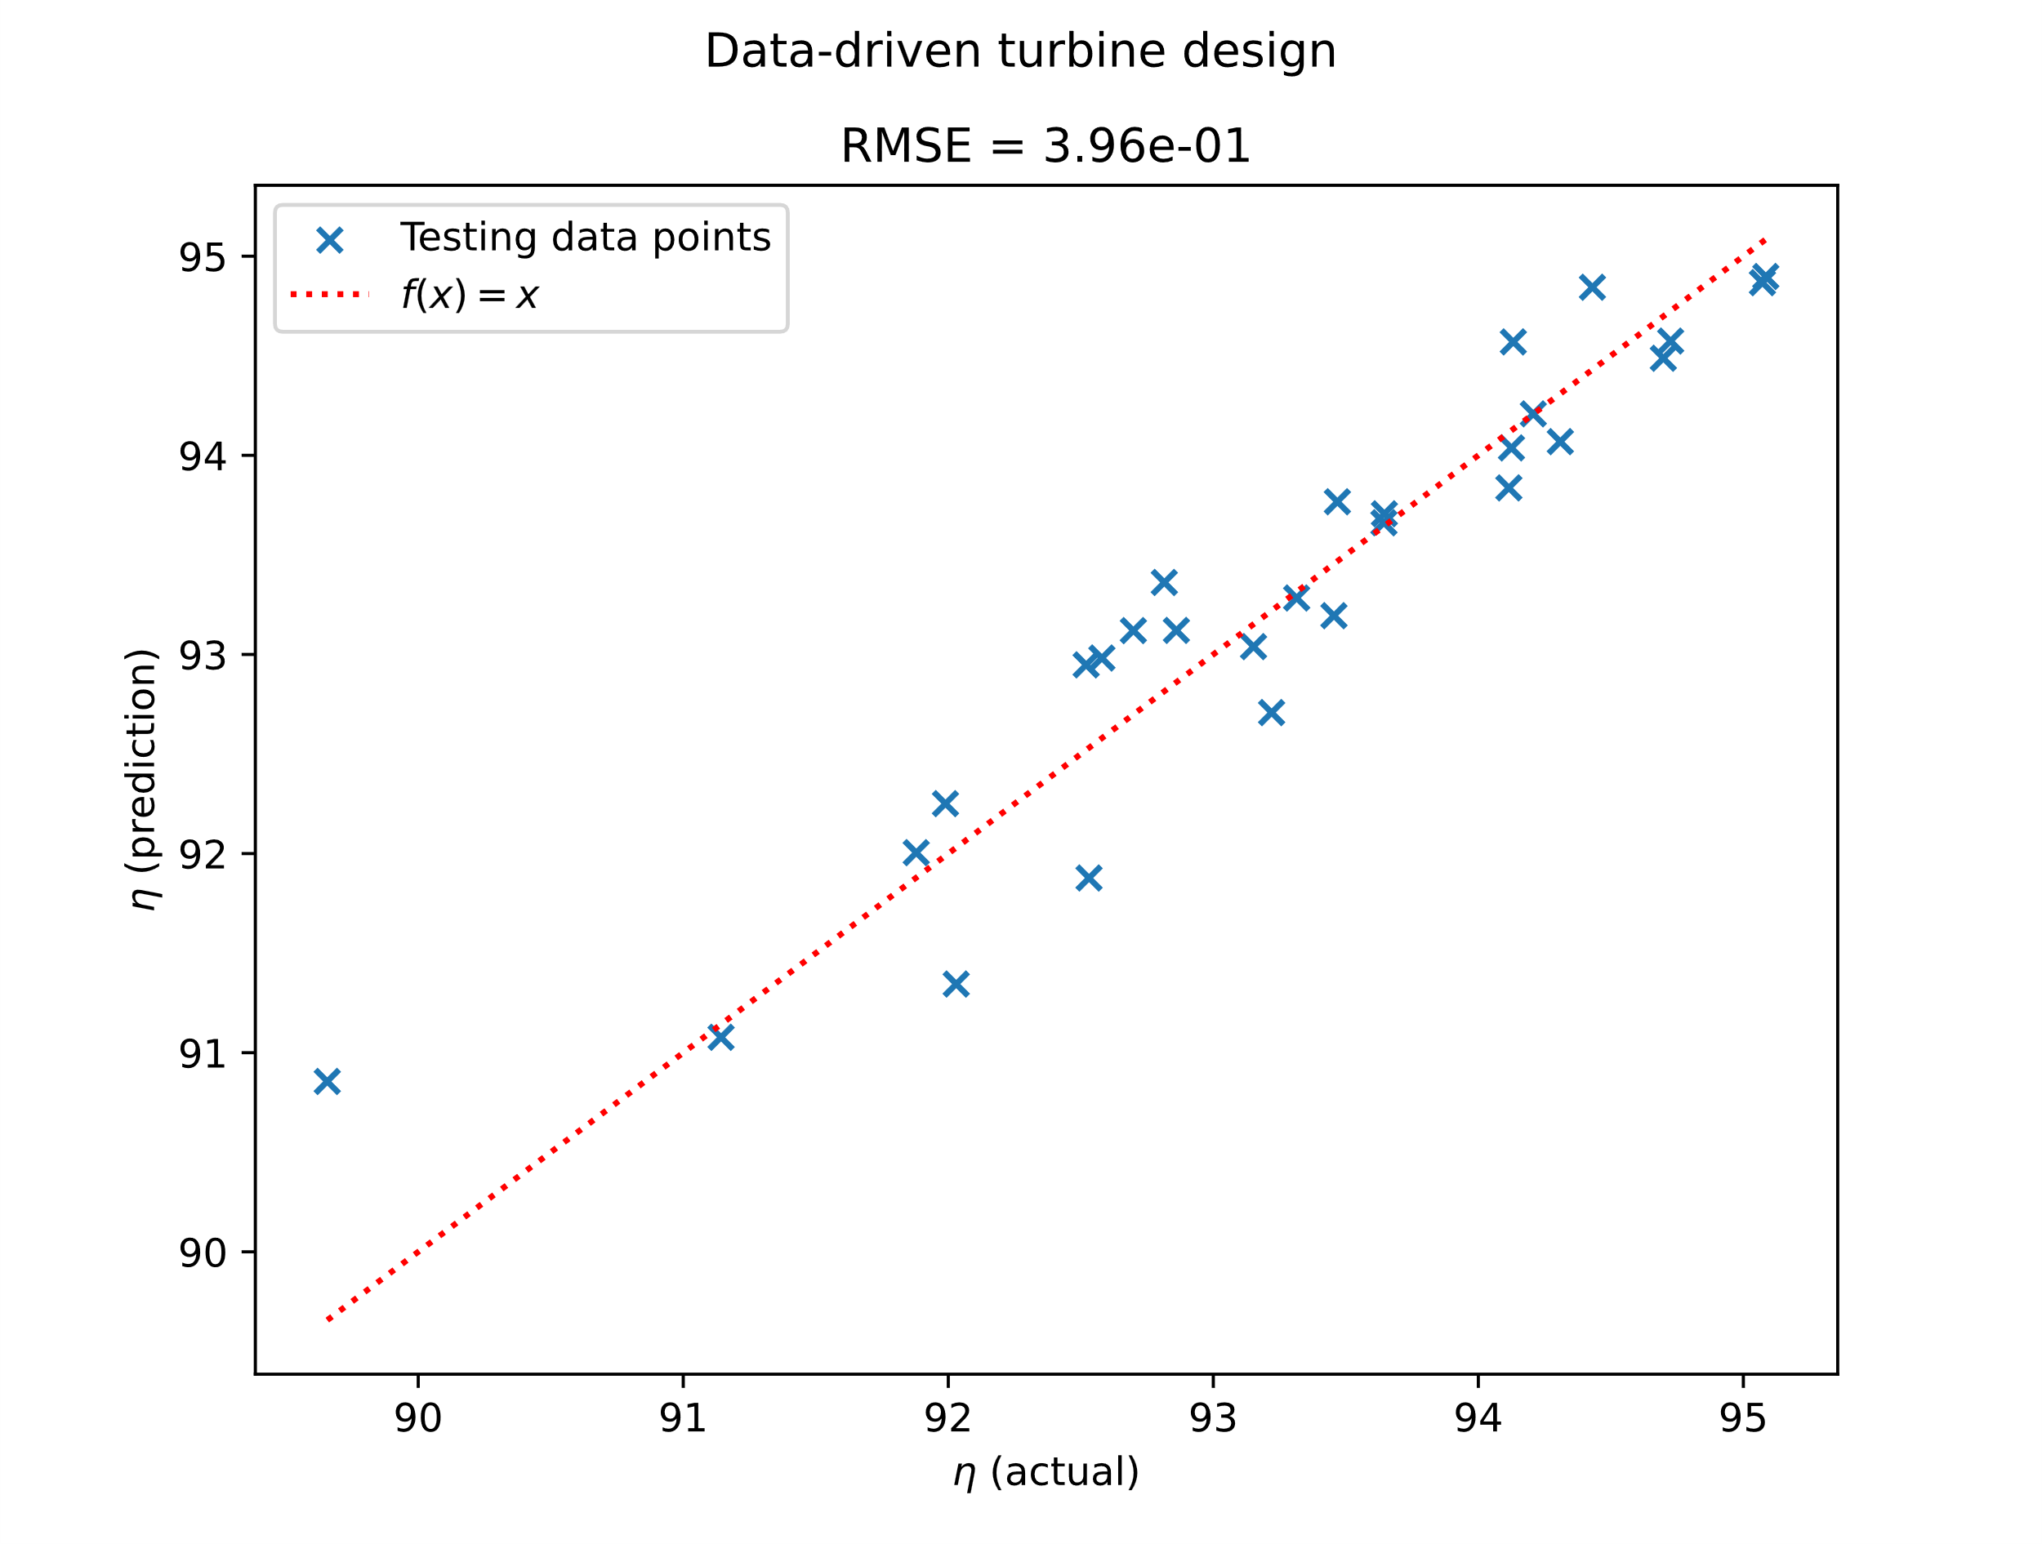
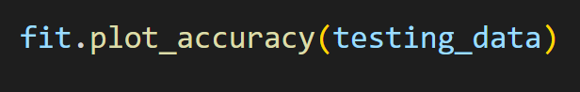
plot_accuracy (example)

Slide 20
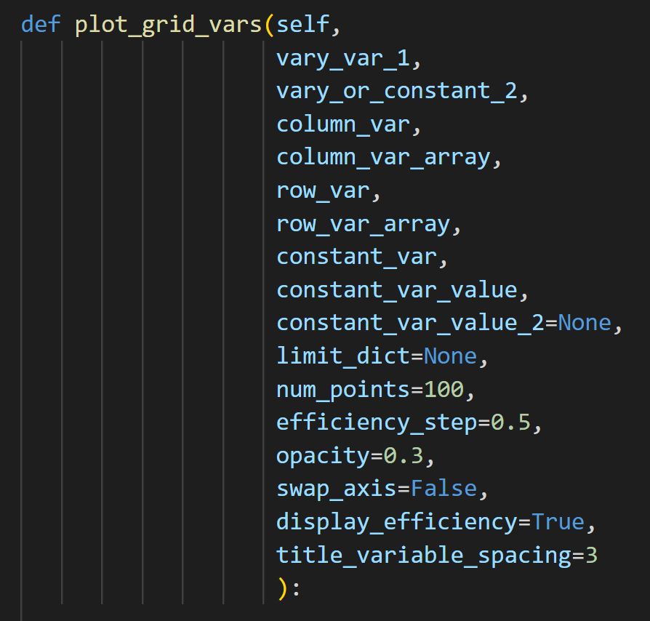
plot_grid_vars

Slide 21
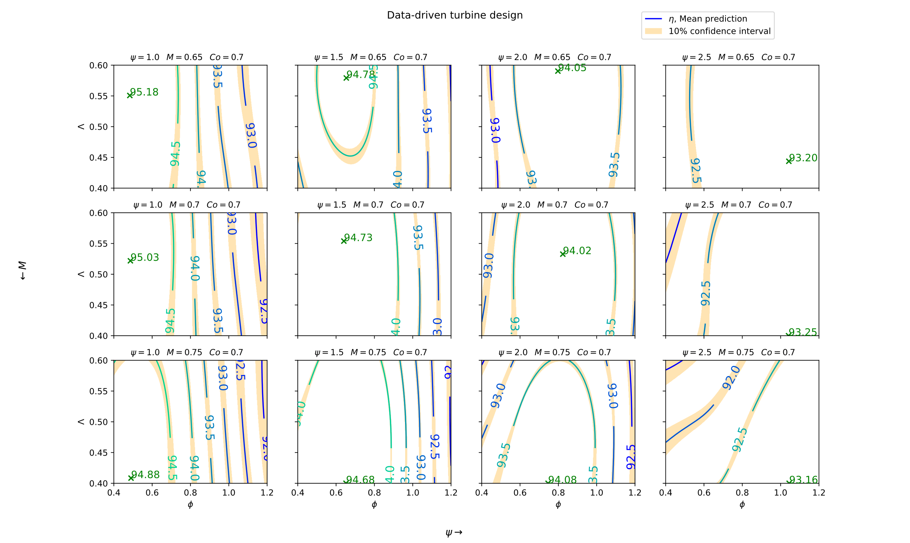
plot_grid_vars (examples)

Slide 22
Week 3 M
Improvement of design tool. Assessment of current accuracy and need for more data

Slide 23
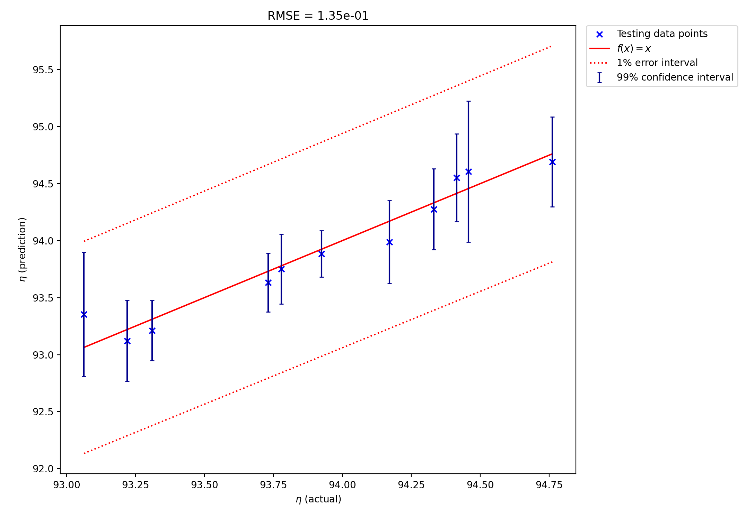
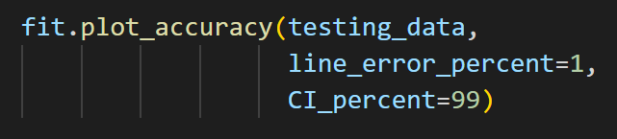
‘2D’ data accuracy
26 data points. Split into:
14 training points
12 testing points

Slide 24
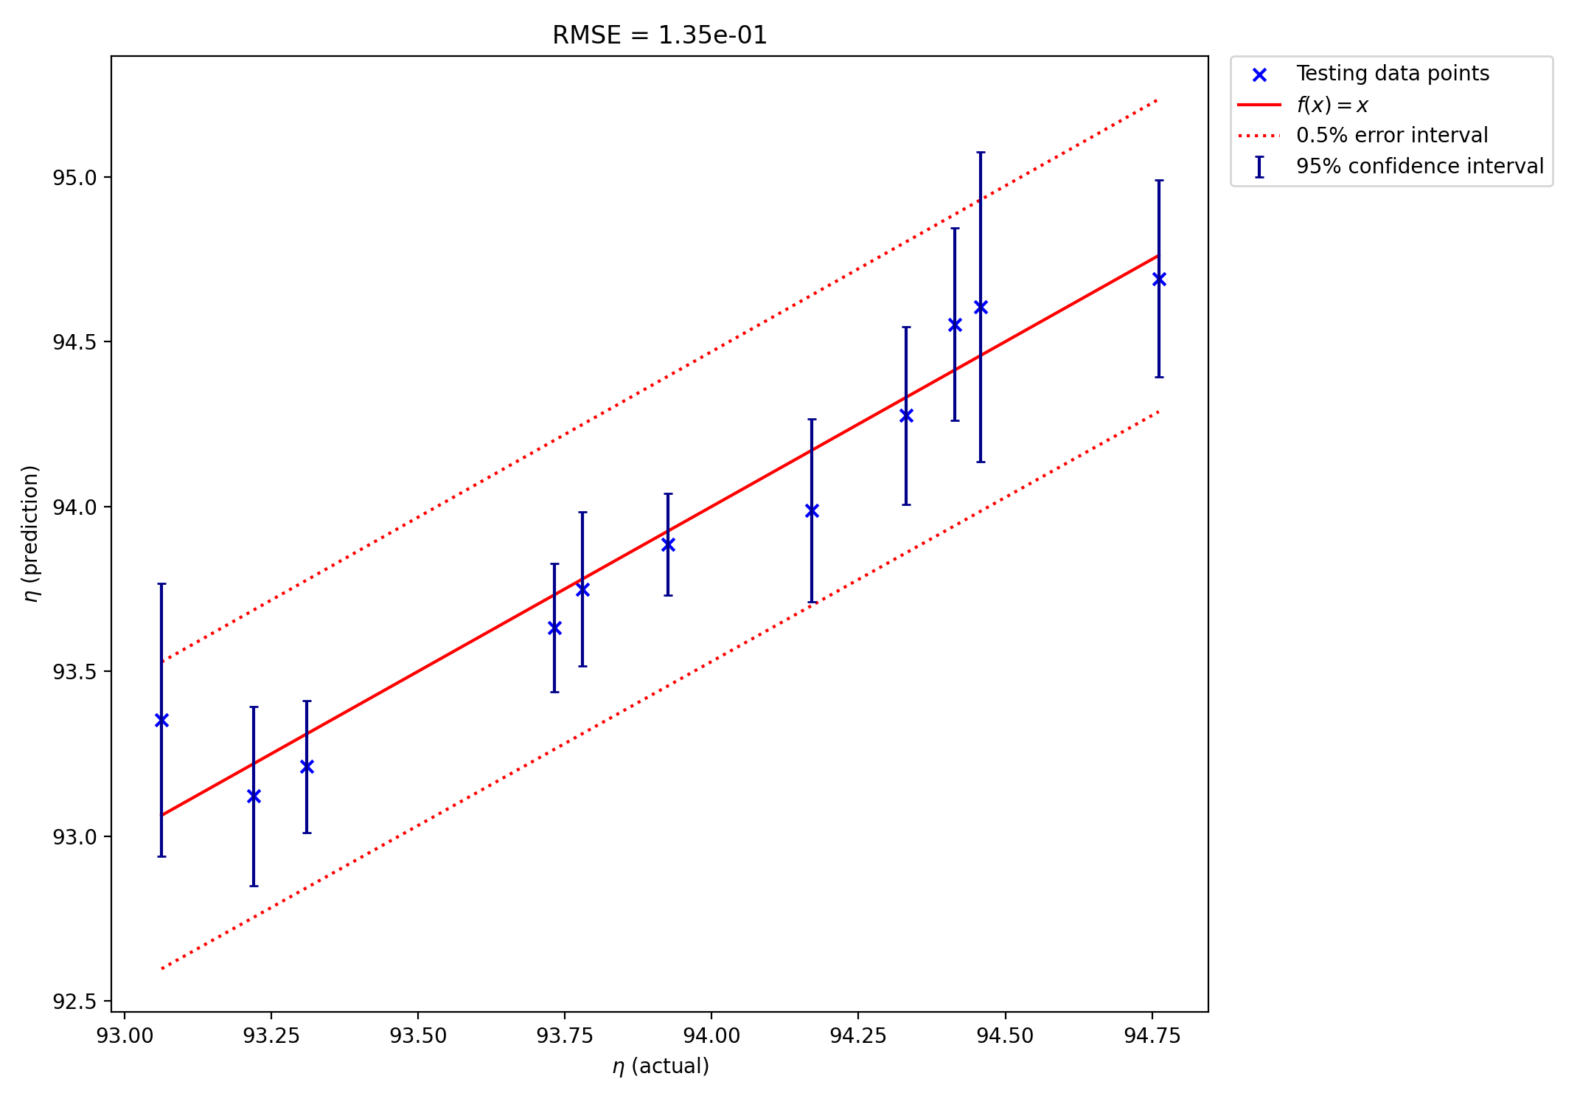
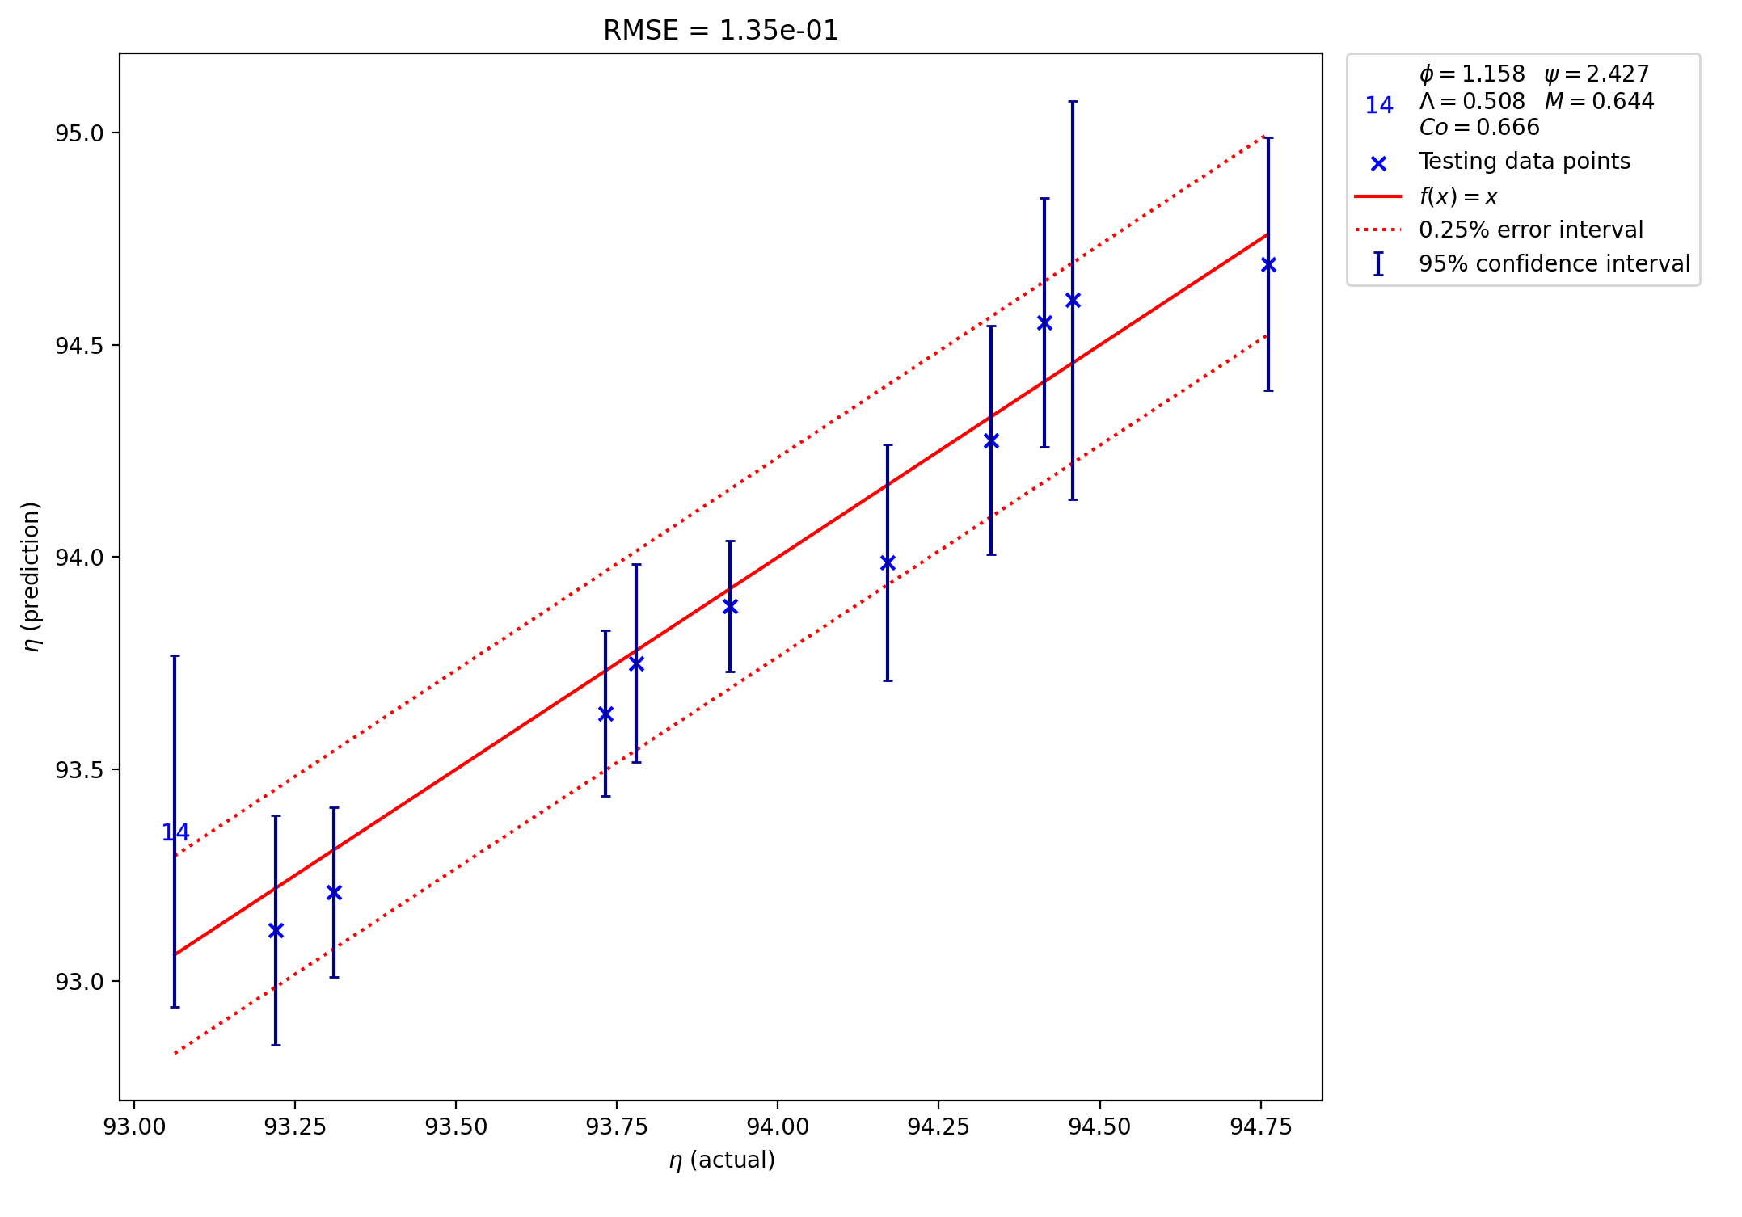
‘2D’ data accuracy

Slide 25
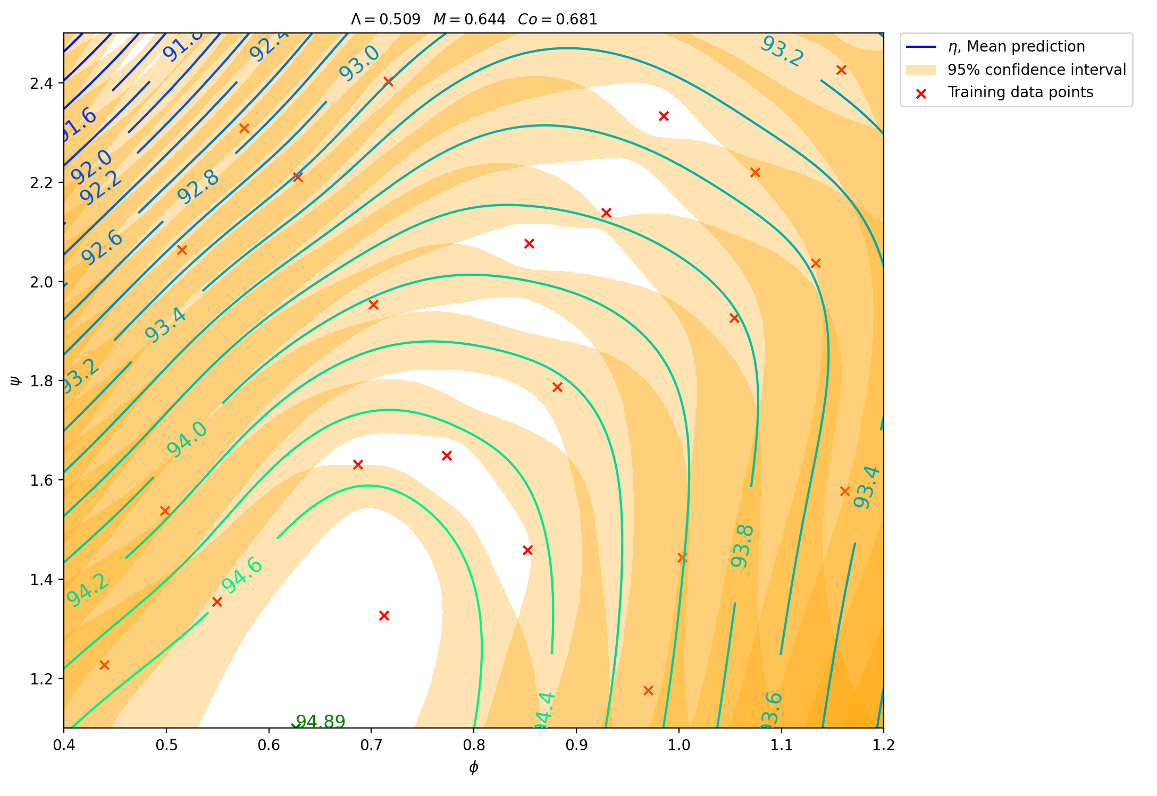
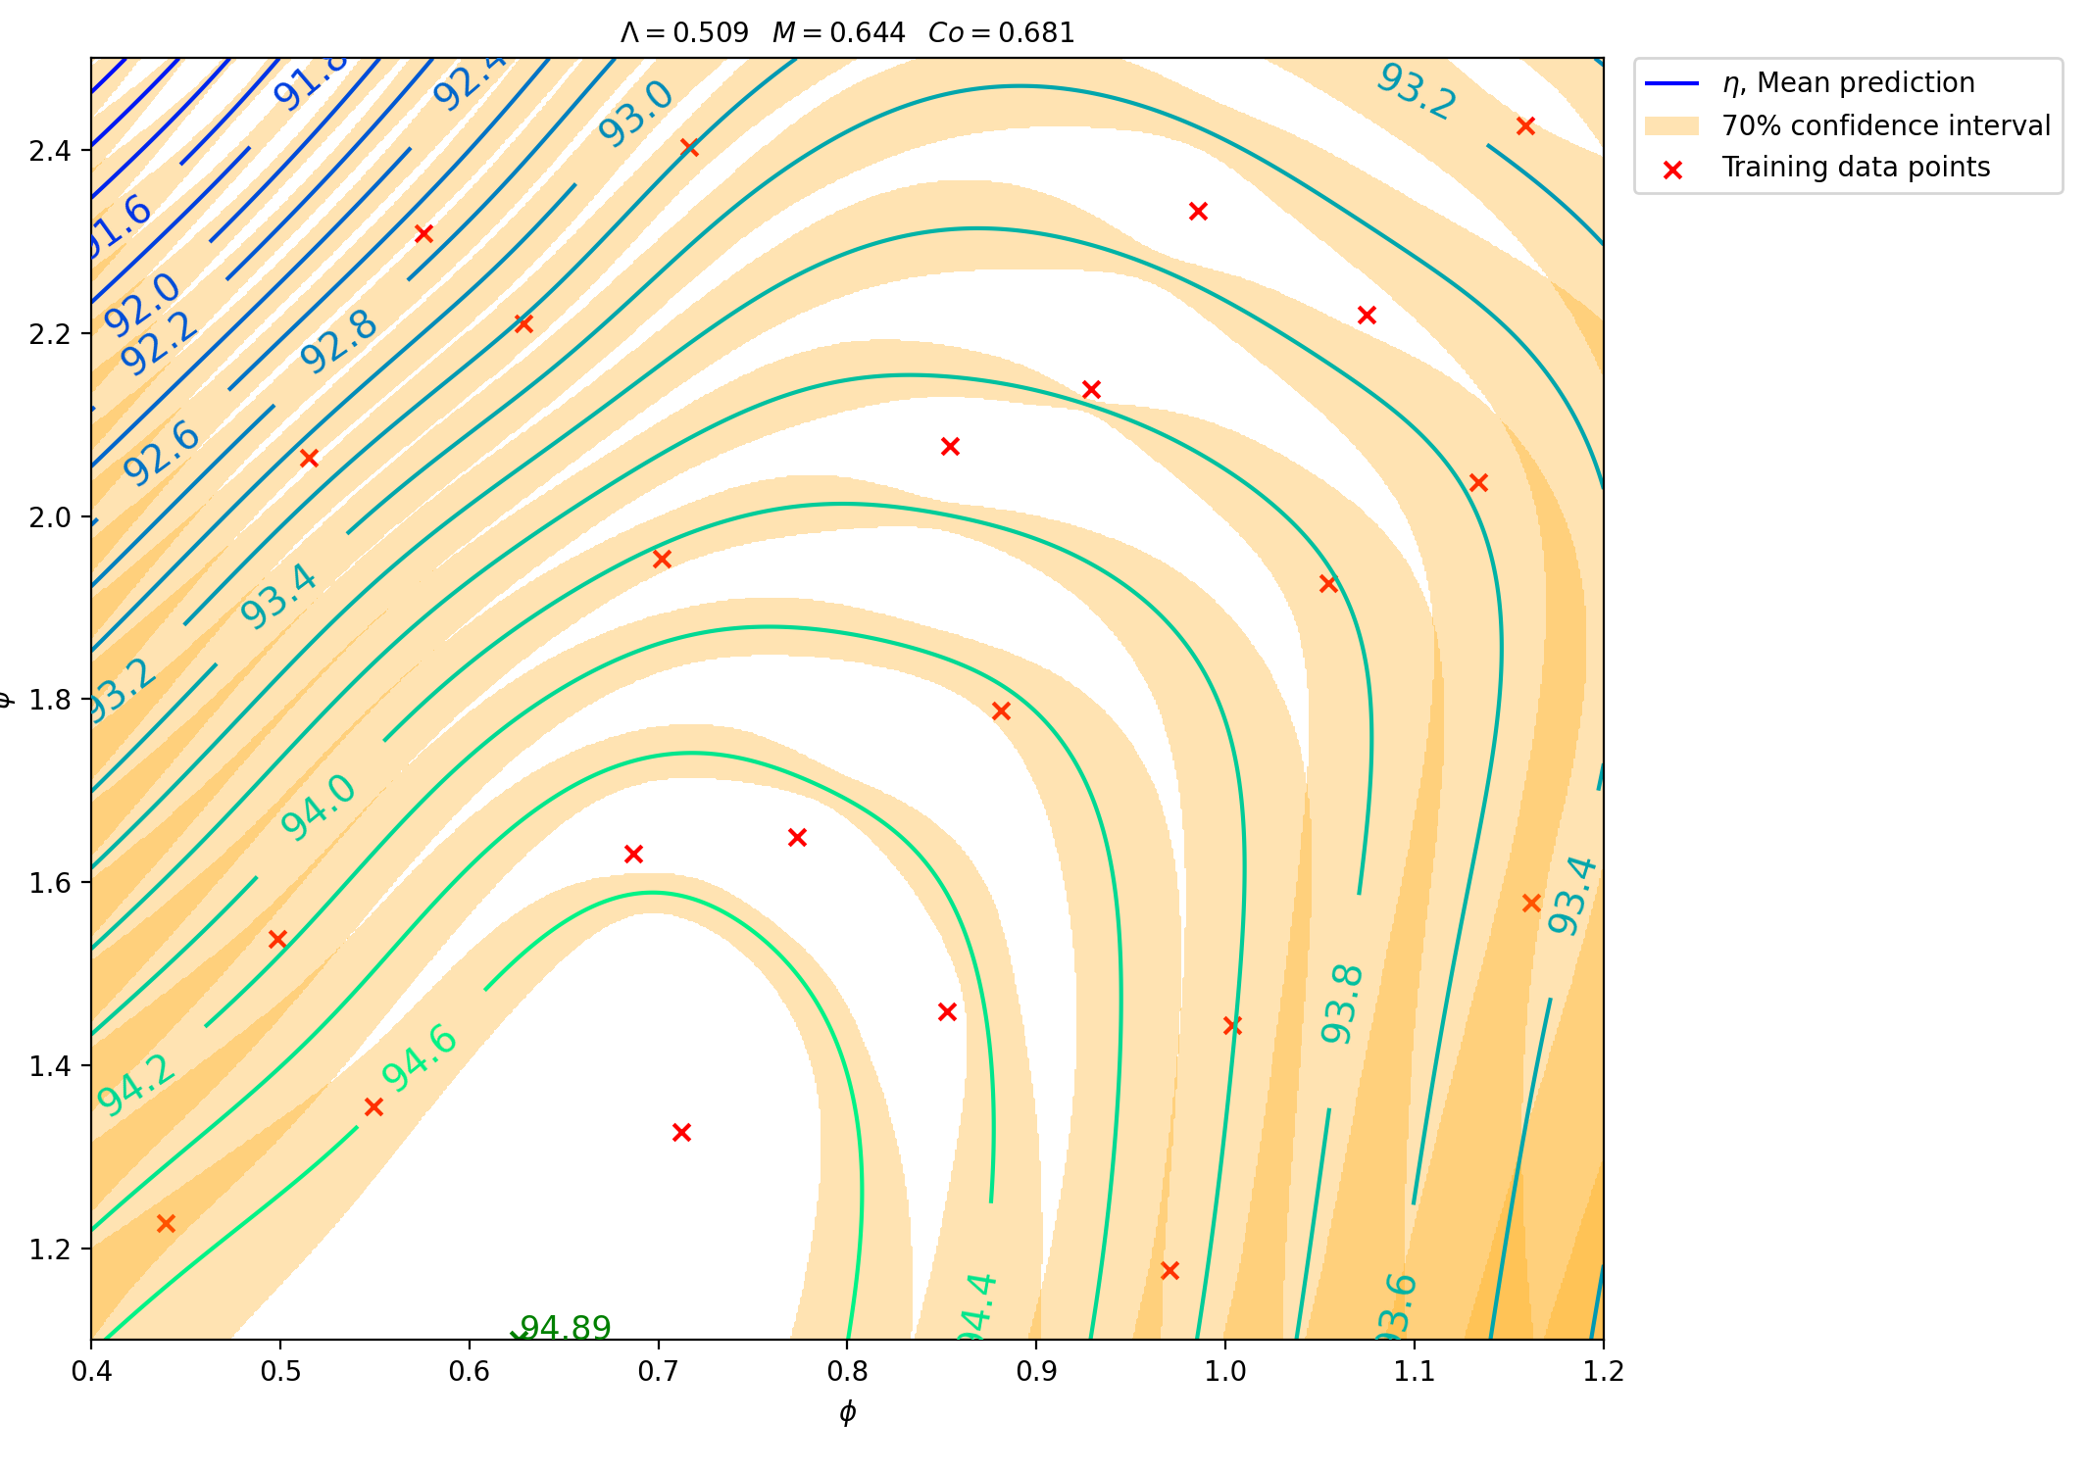
‘2D’ data plots (using 26 data points for model)

Slide 26
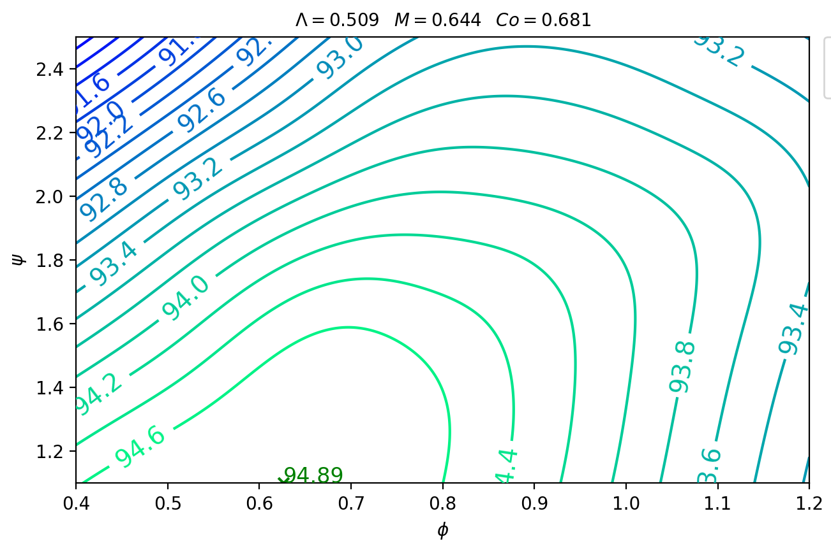
‘2D’ comparison to literature
Literature
Model

Slide 27
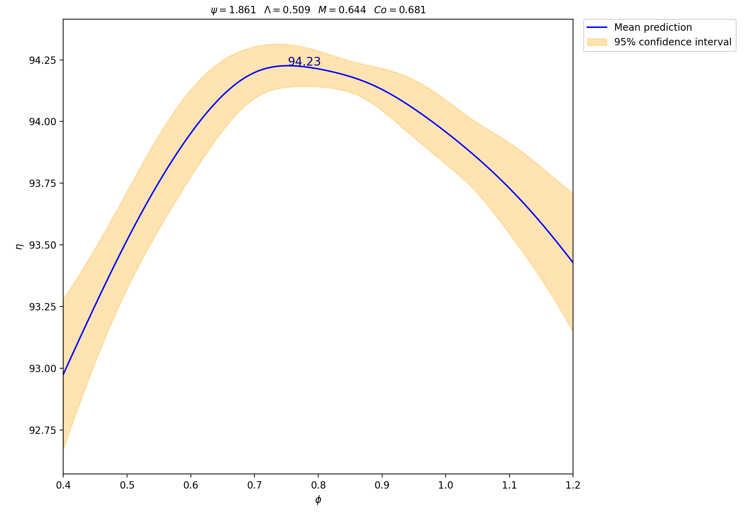
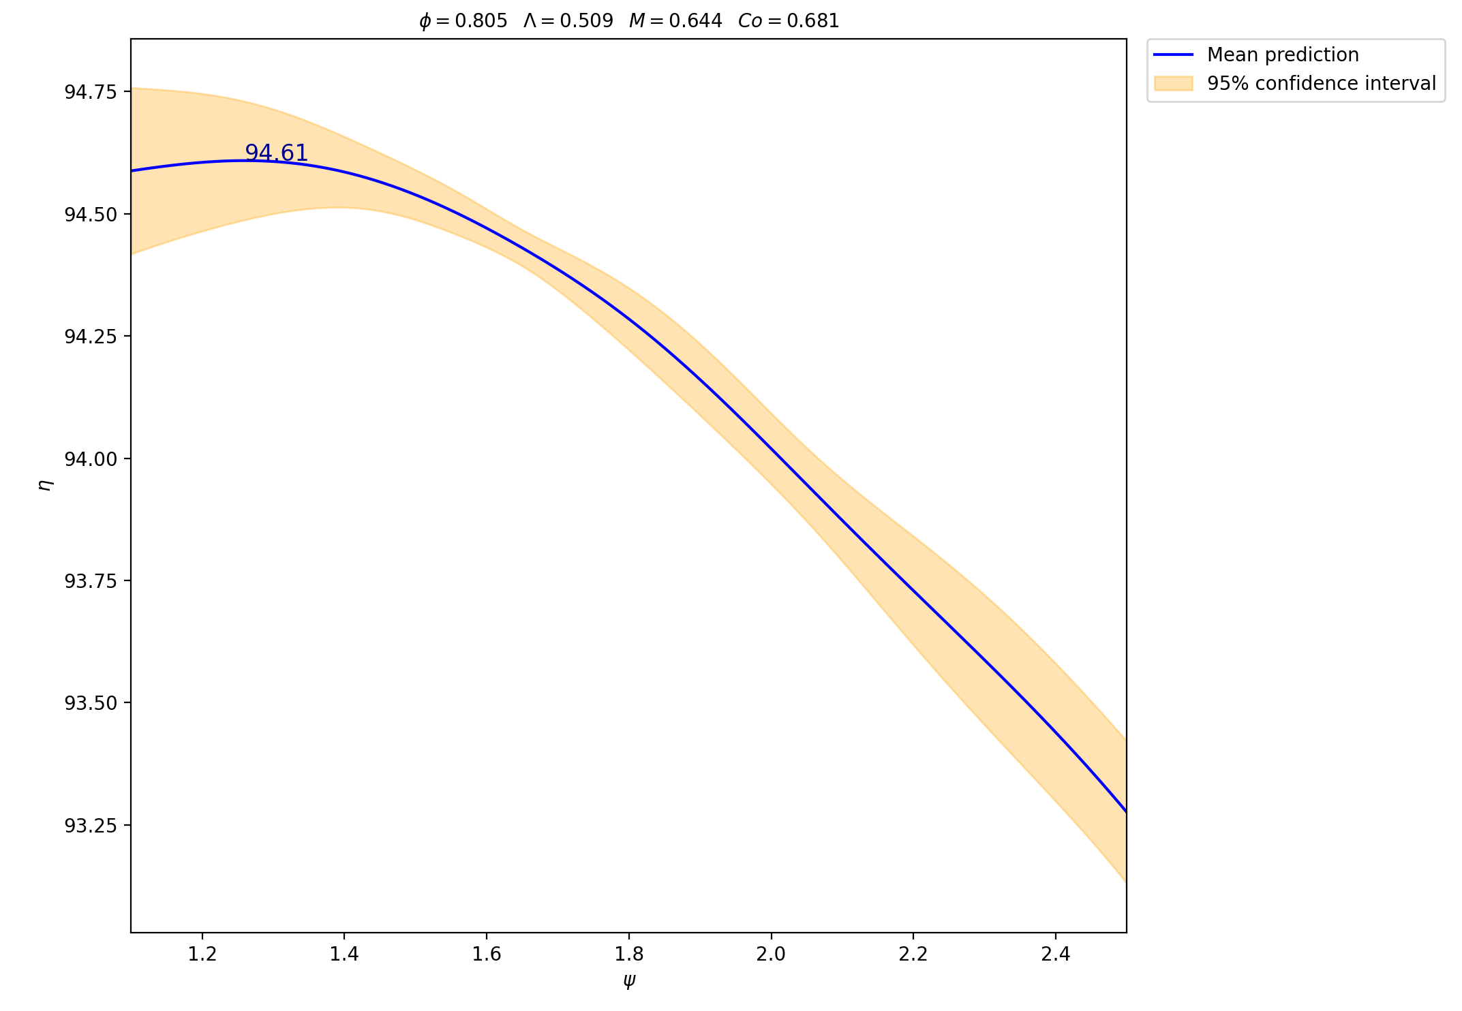
‘2D’ data 1D plots

Slide 28
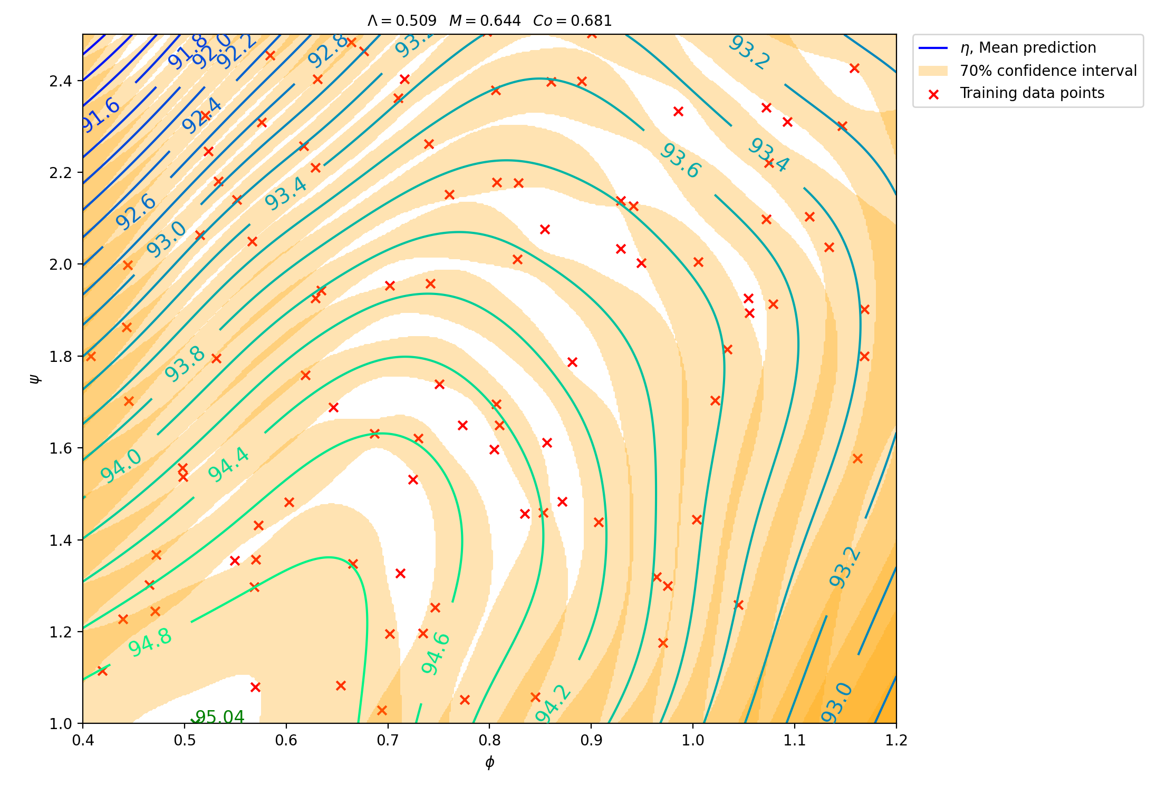
All 105 pieces of data
Model using all data points (105)
Model using just ‘2D’ data points (26)

Slide 29
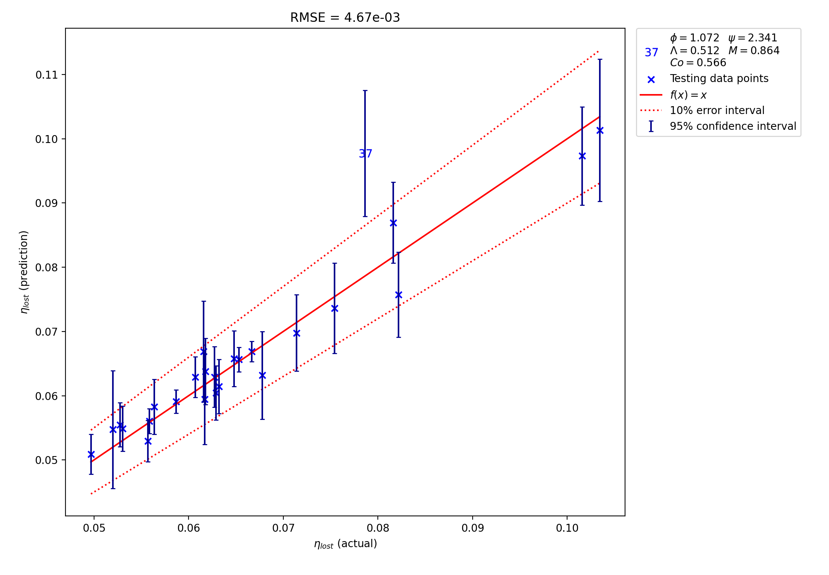
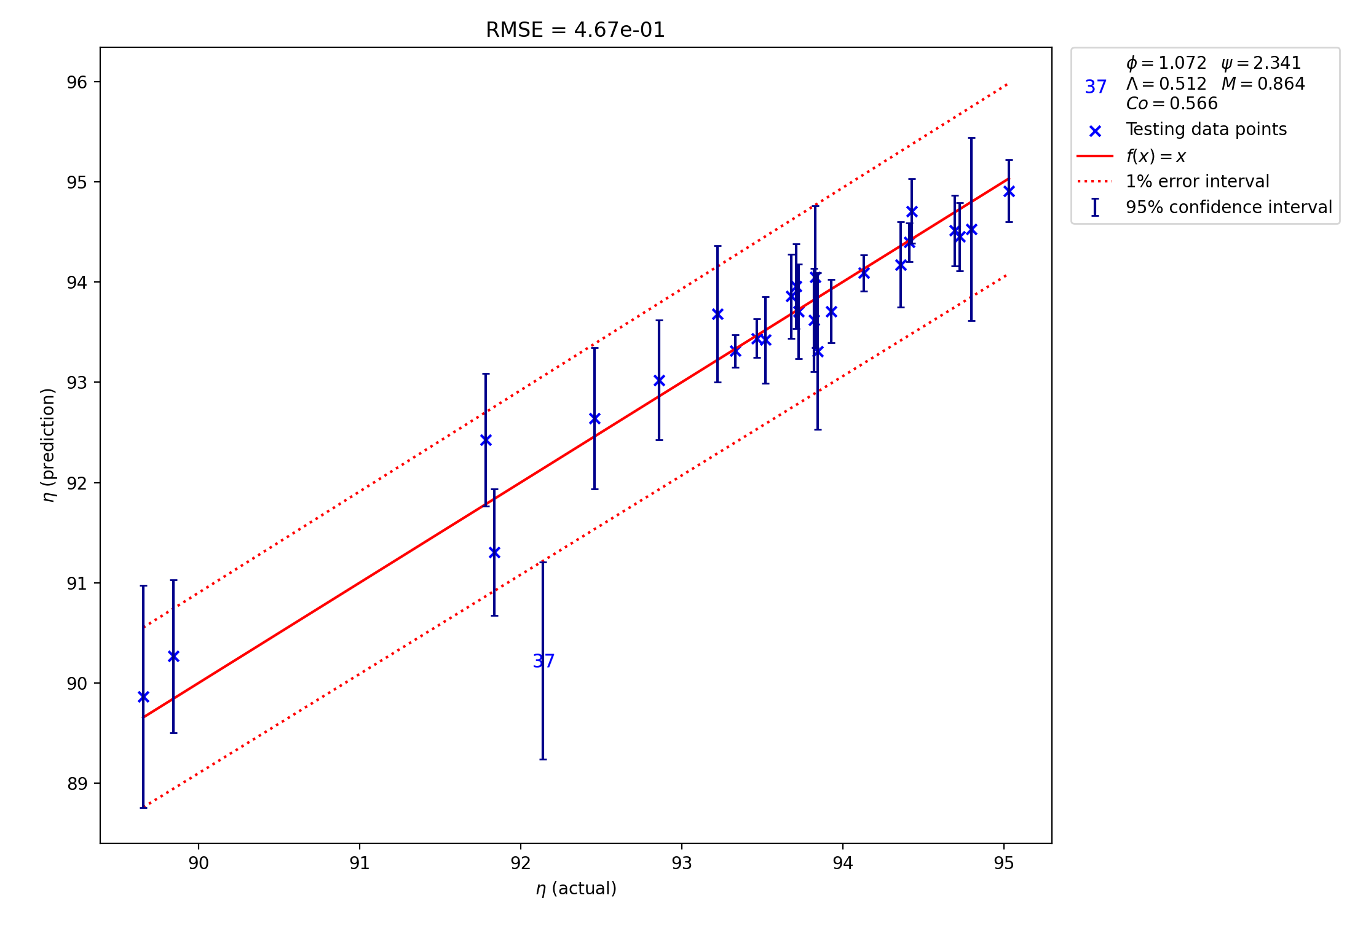
Accuracy of 105 data points
Plotting lost efficiency
Plotting efficiency

Slide 30
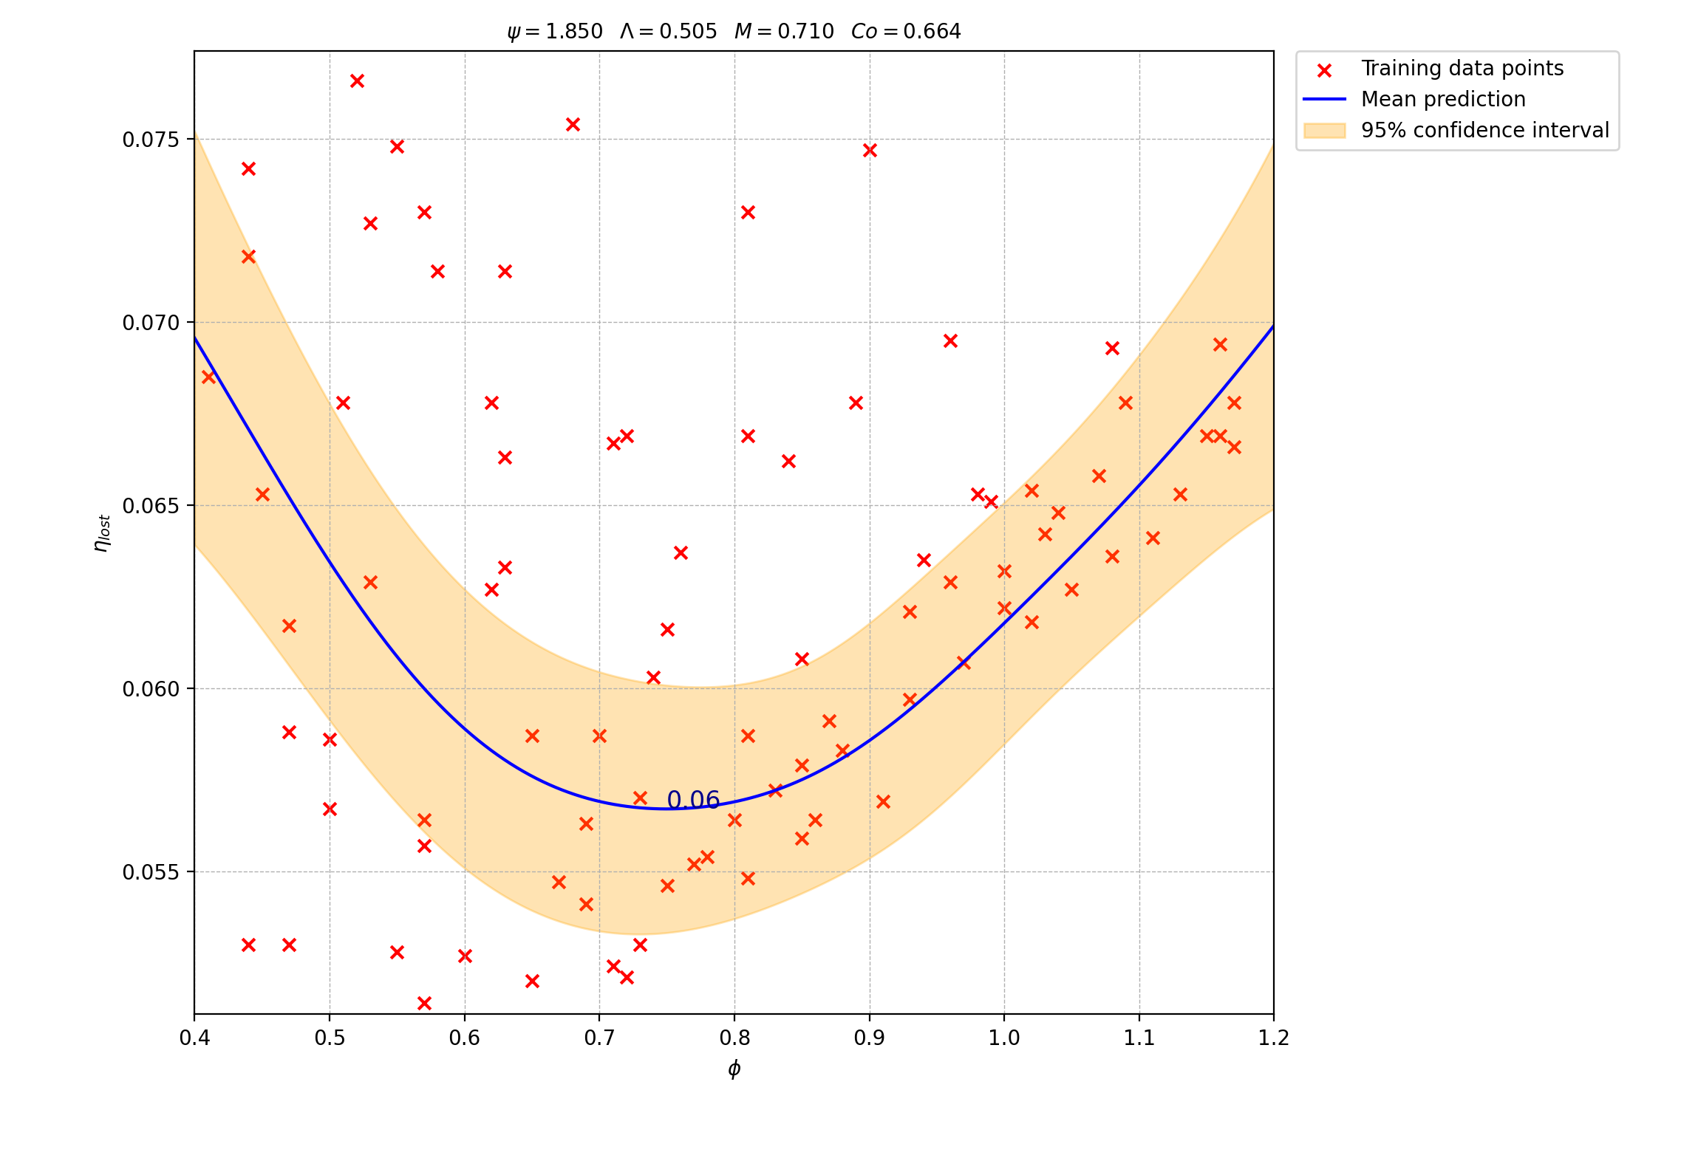
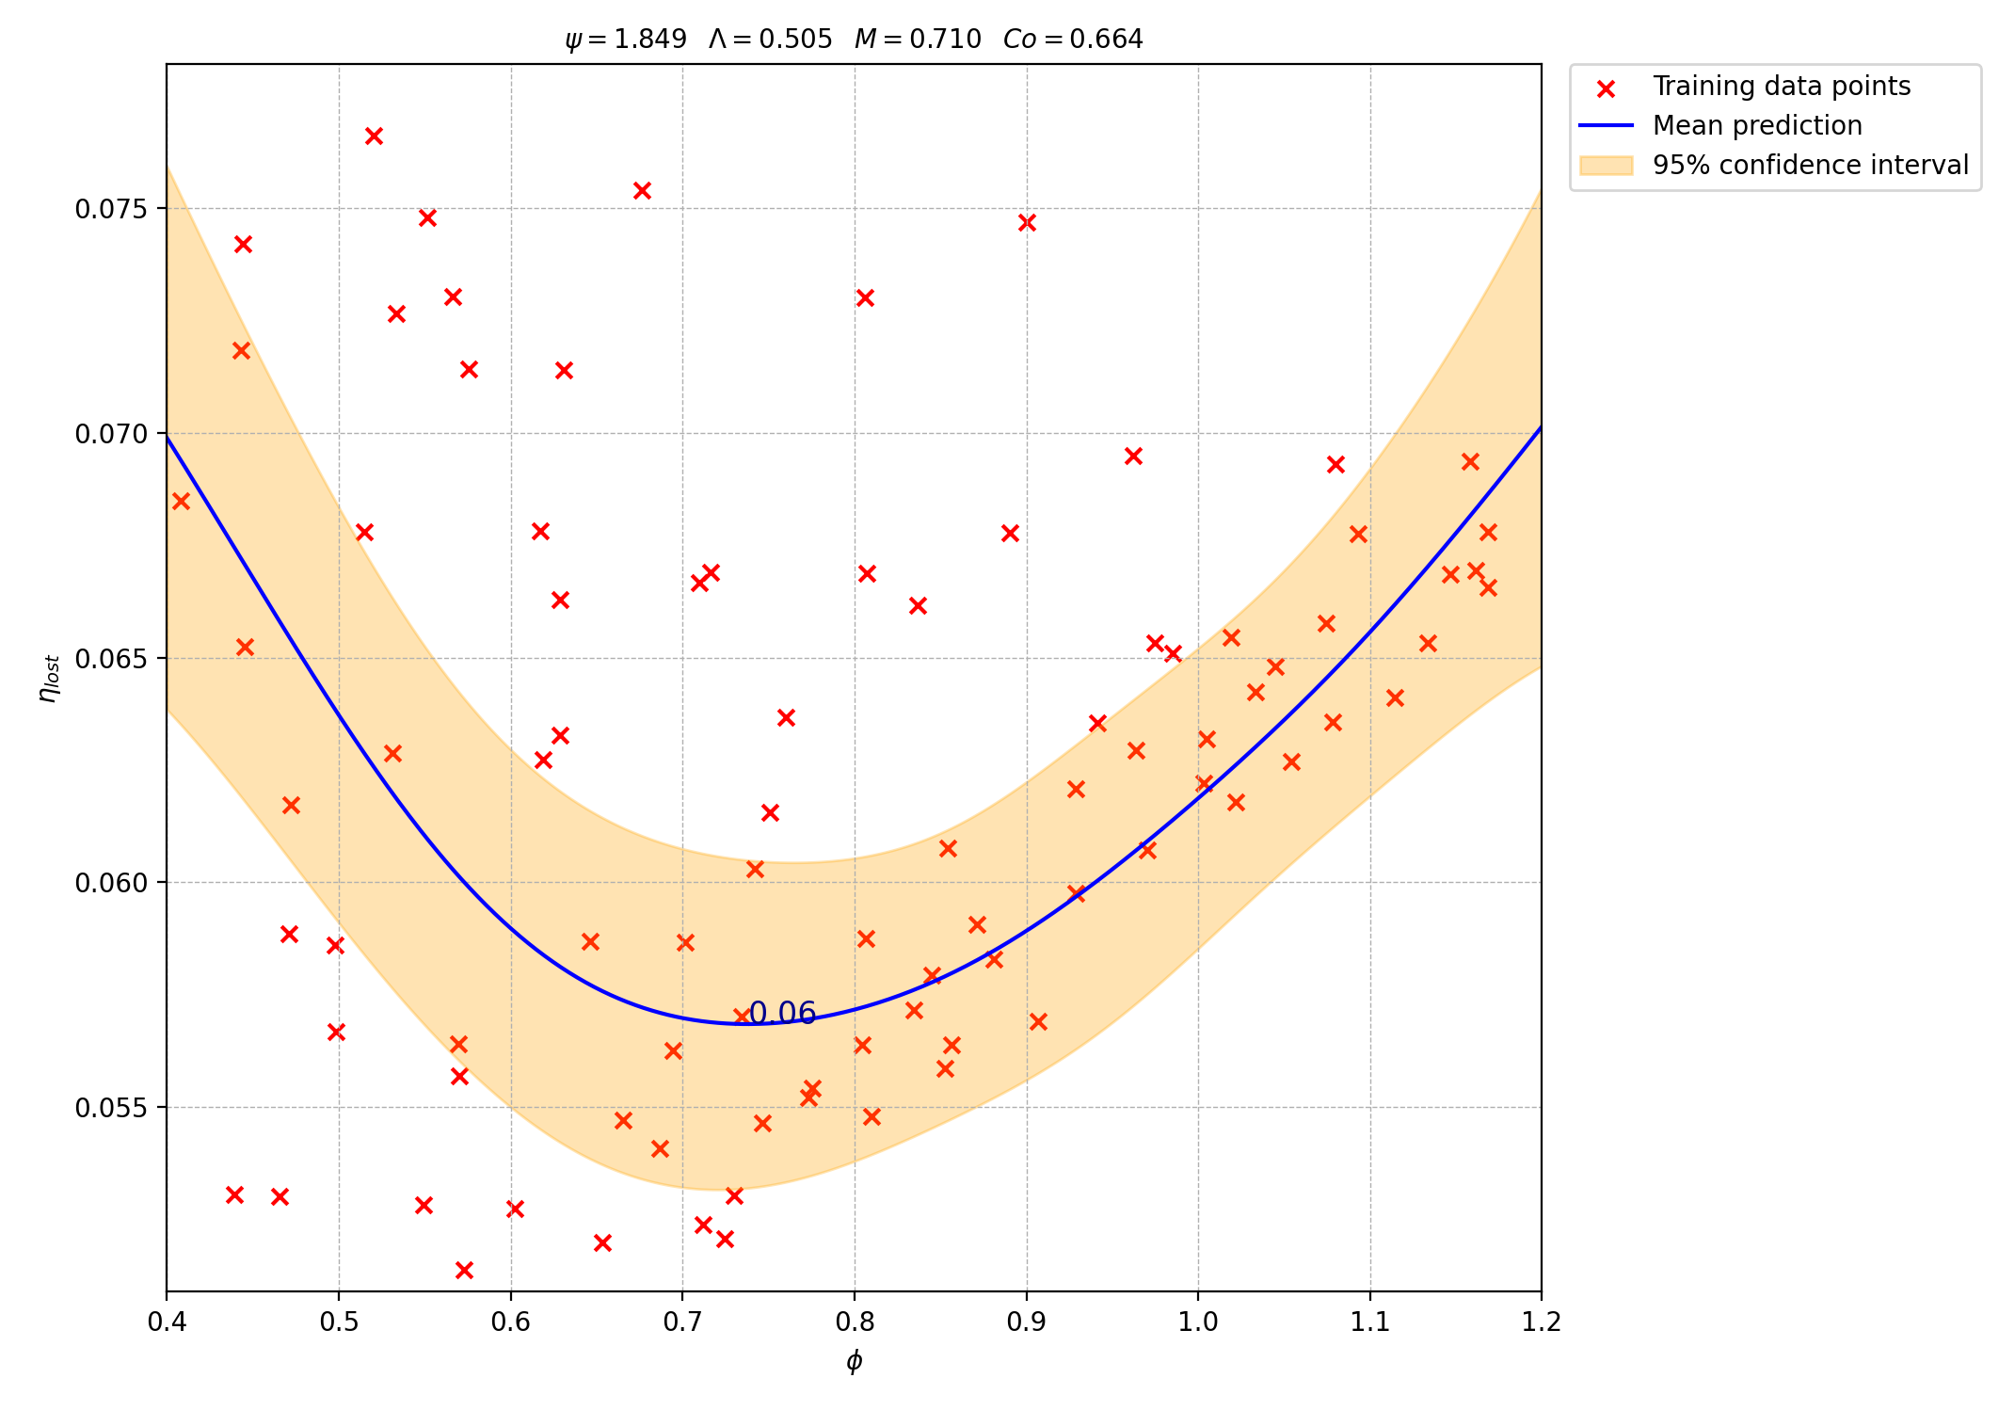
Effect of rounding dataframe values to 3sf
rounded
not rounded

Slide 31
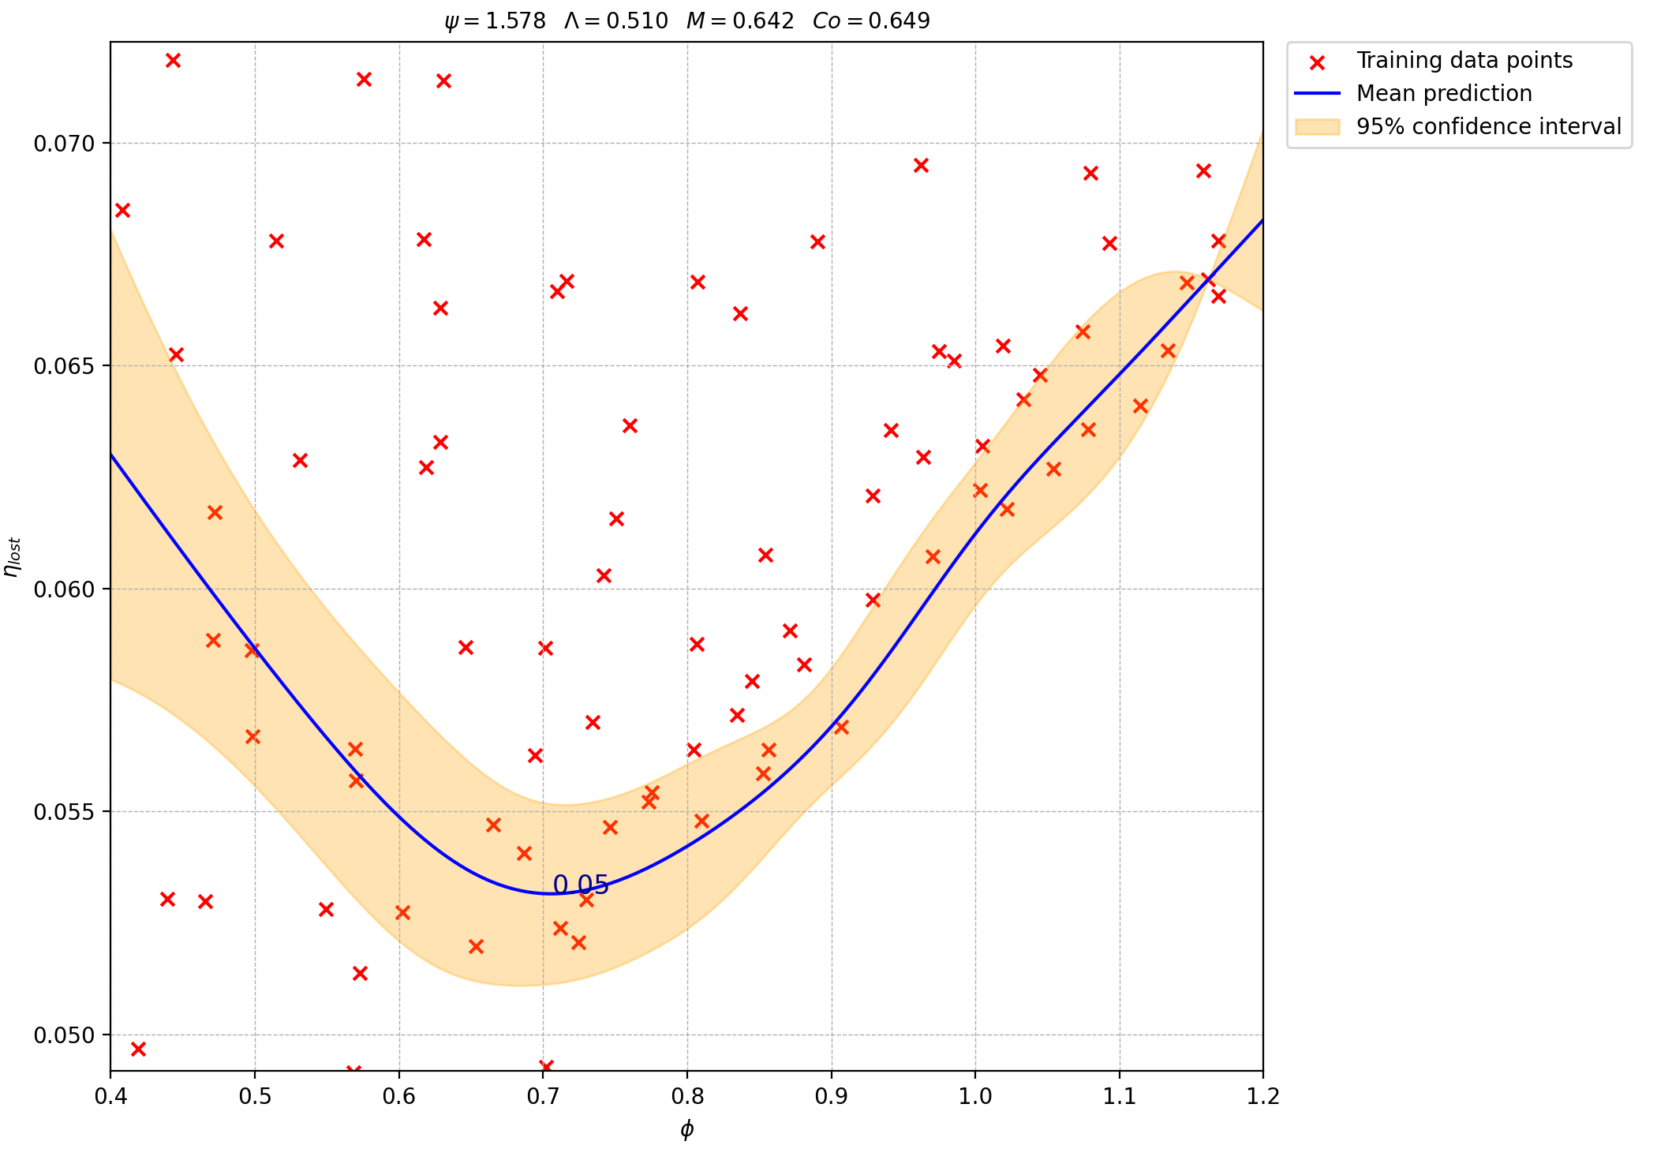
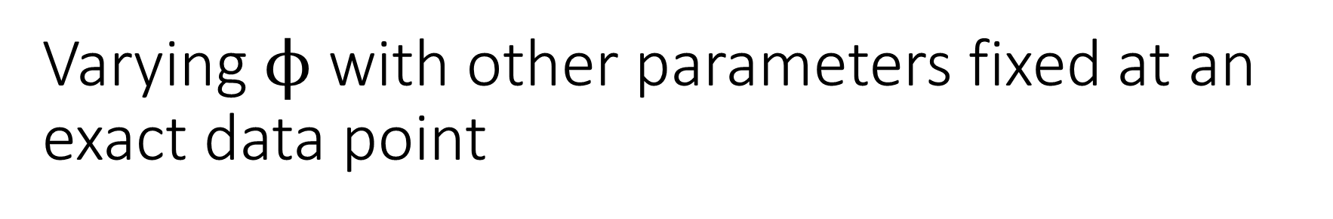
Varying $ϕ$ with other parameters fixed at an exact data point

Slide 32
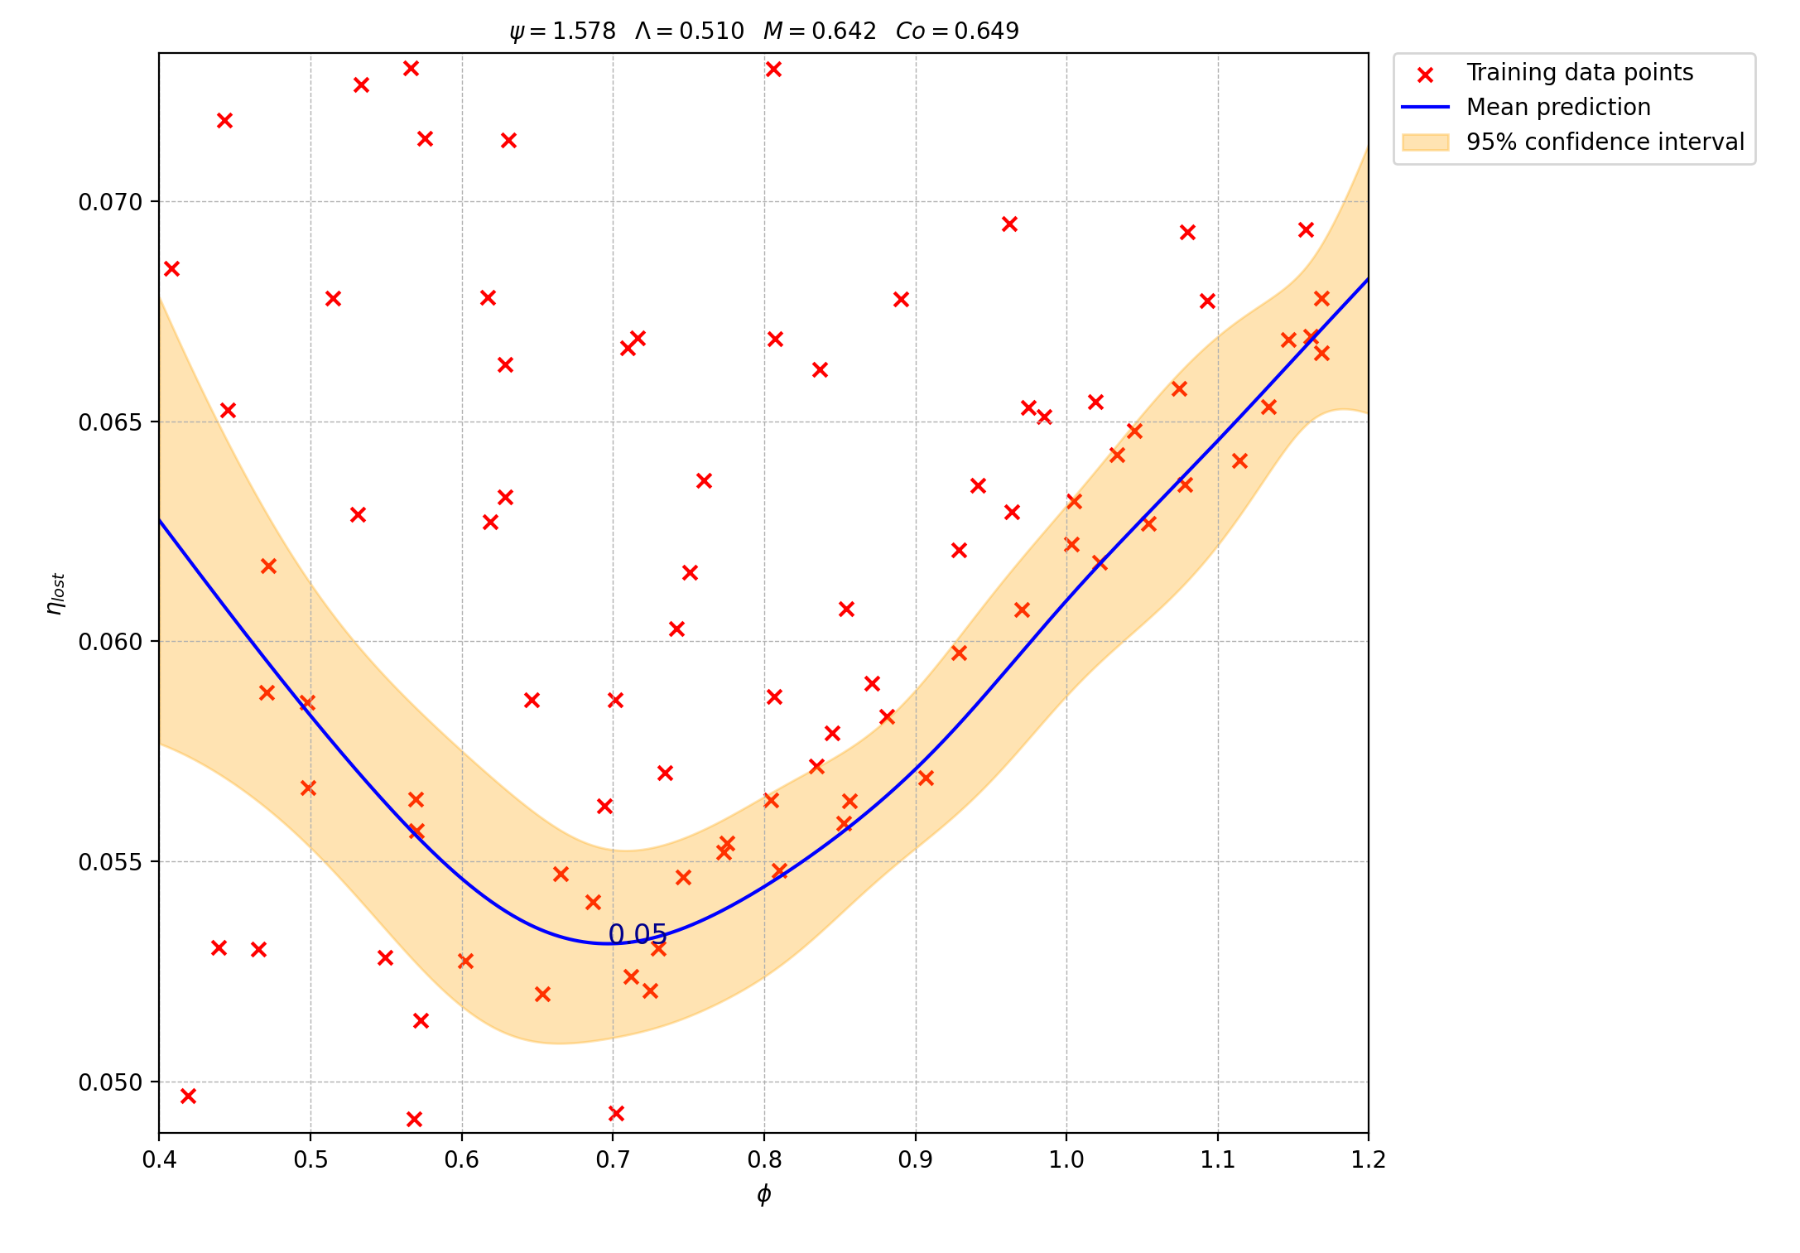
Effect of noise
No noise
Noise (alpha=1e-6)

Slide 33
Week 4 M
Learning how to run more simulations and use the HPC.

Slide 34
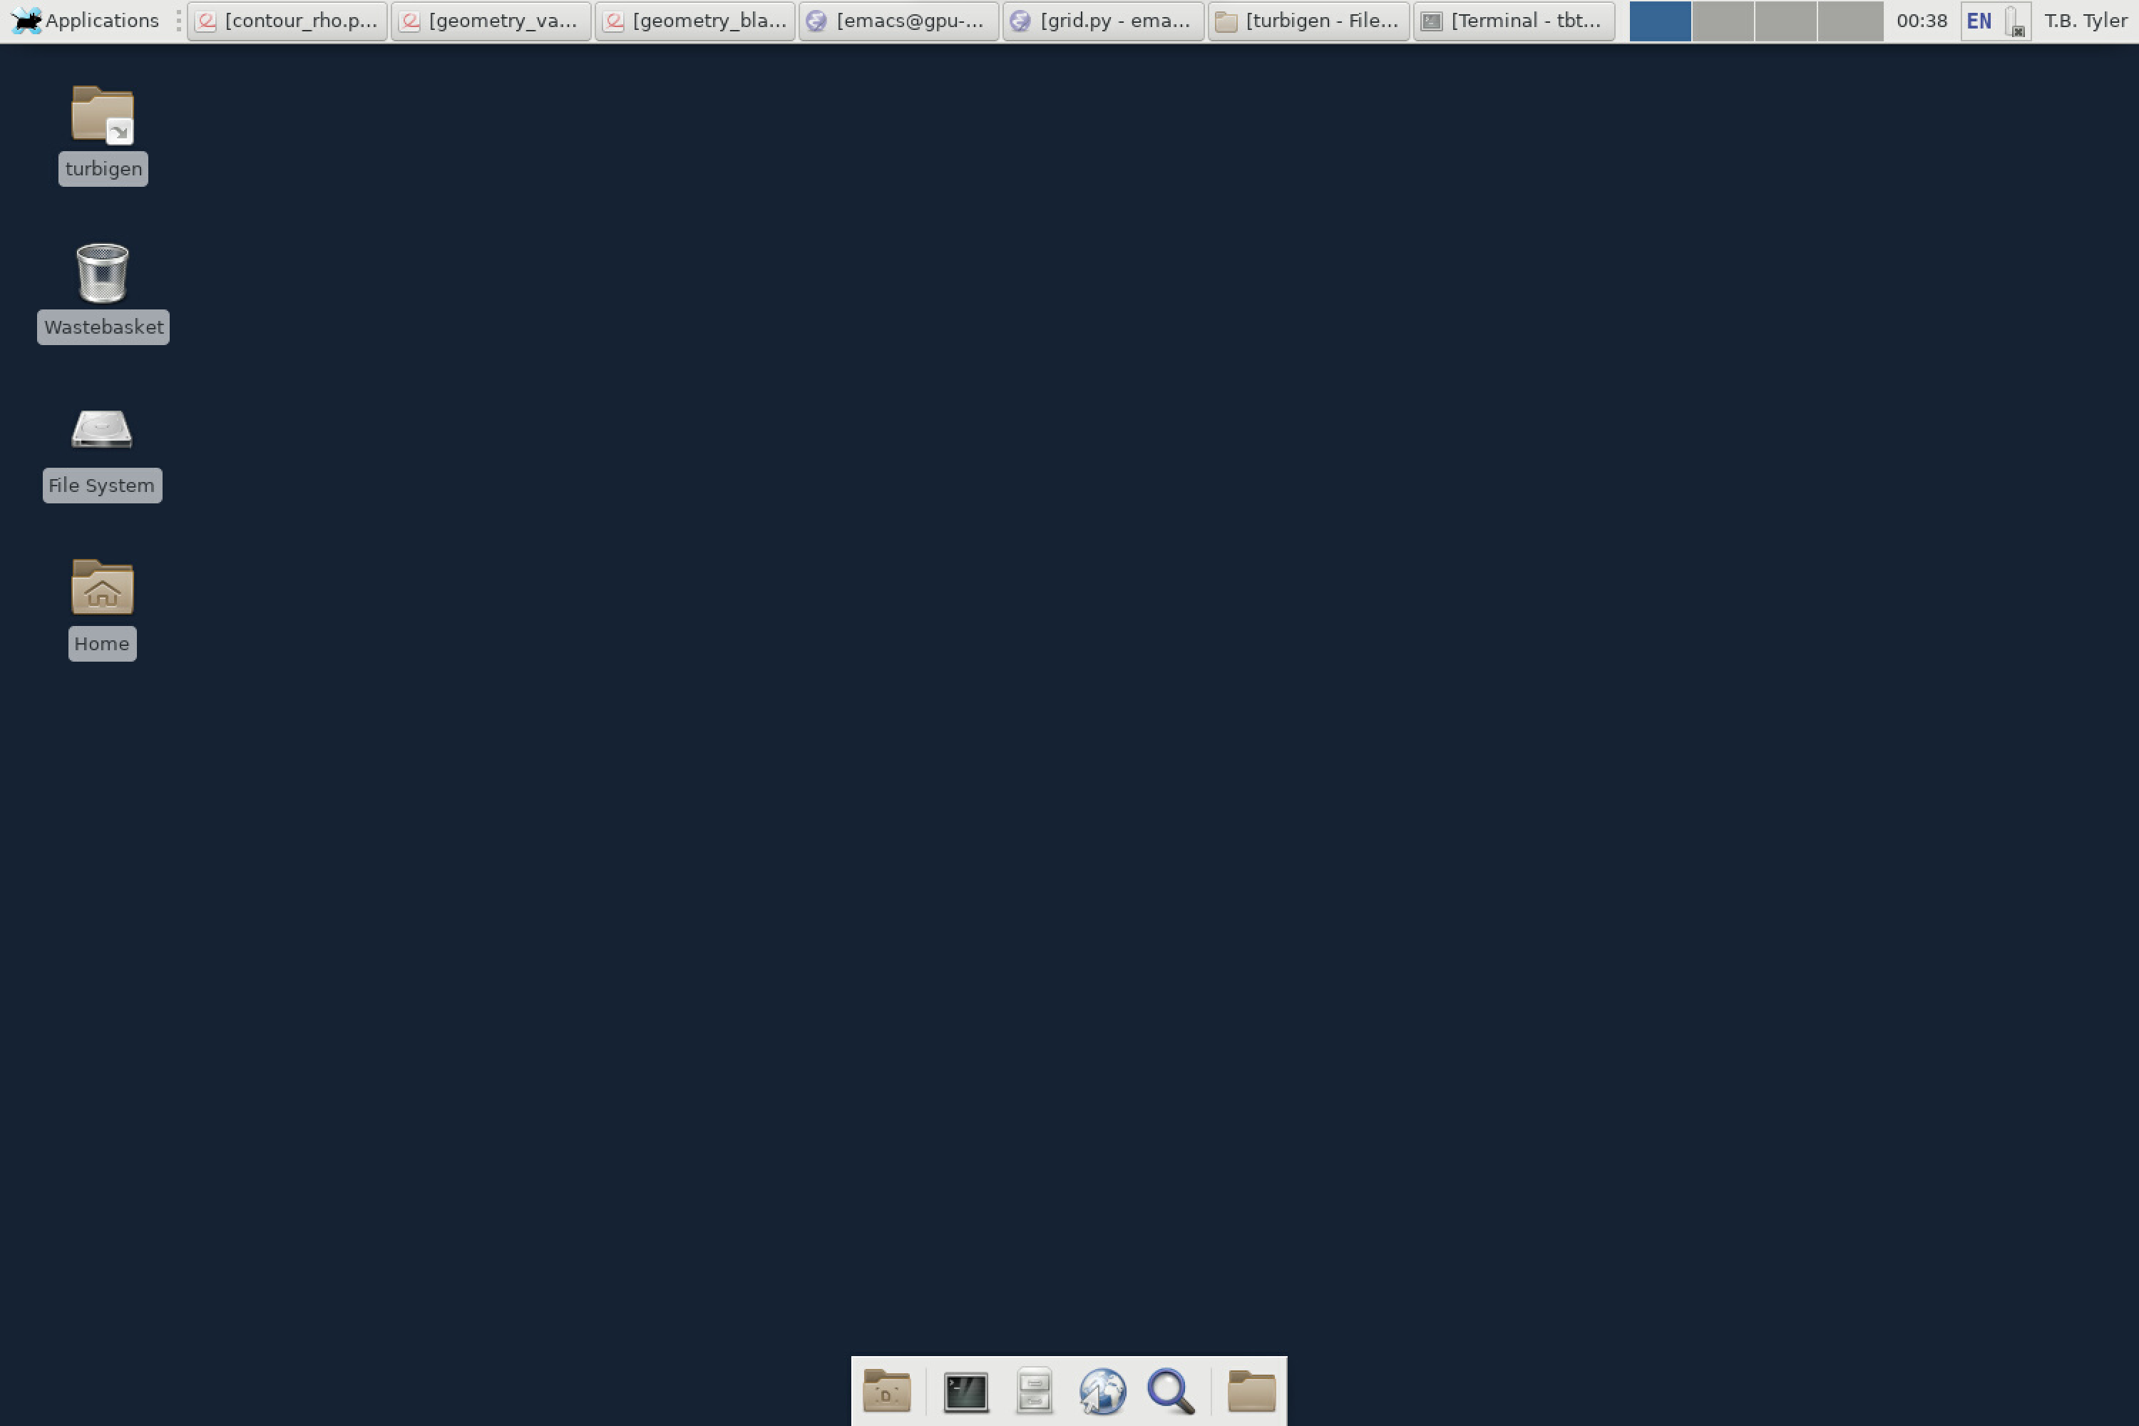
User Interface

Slide 35
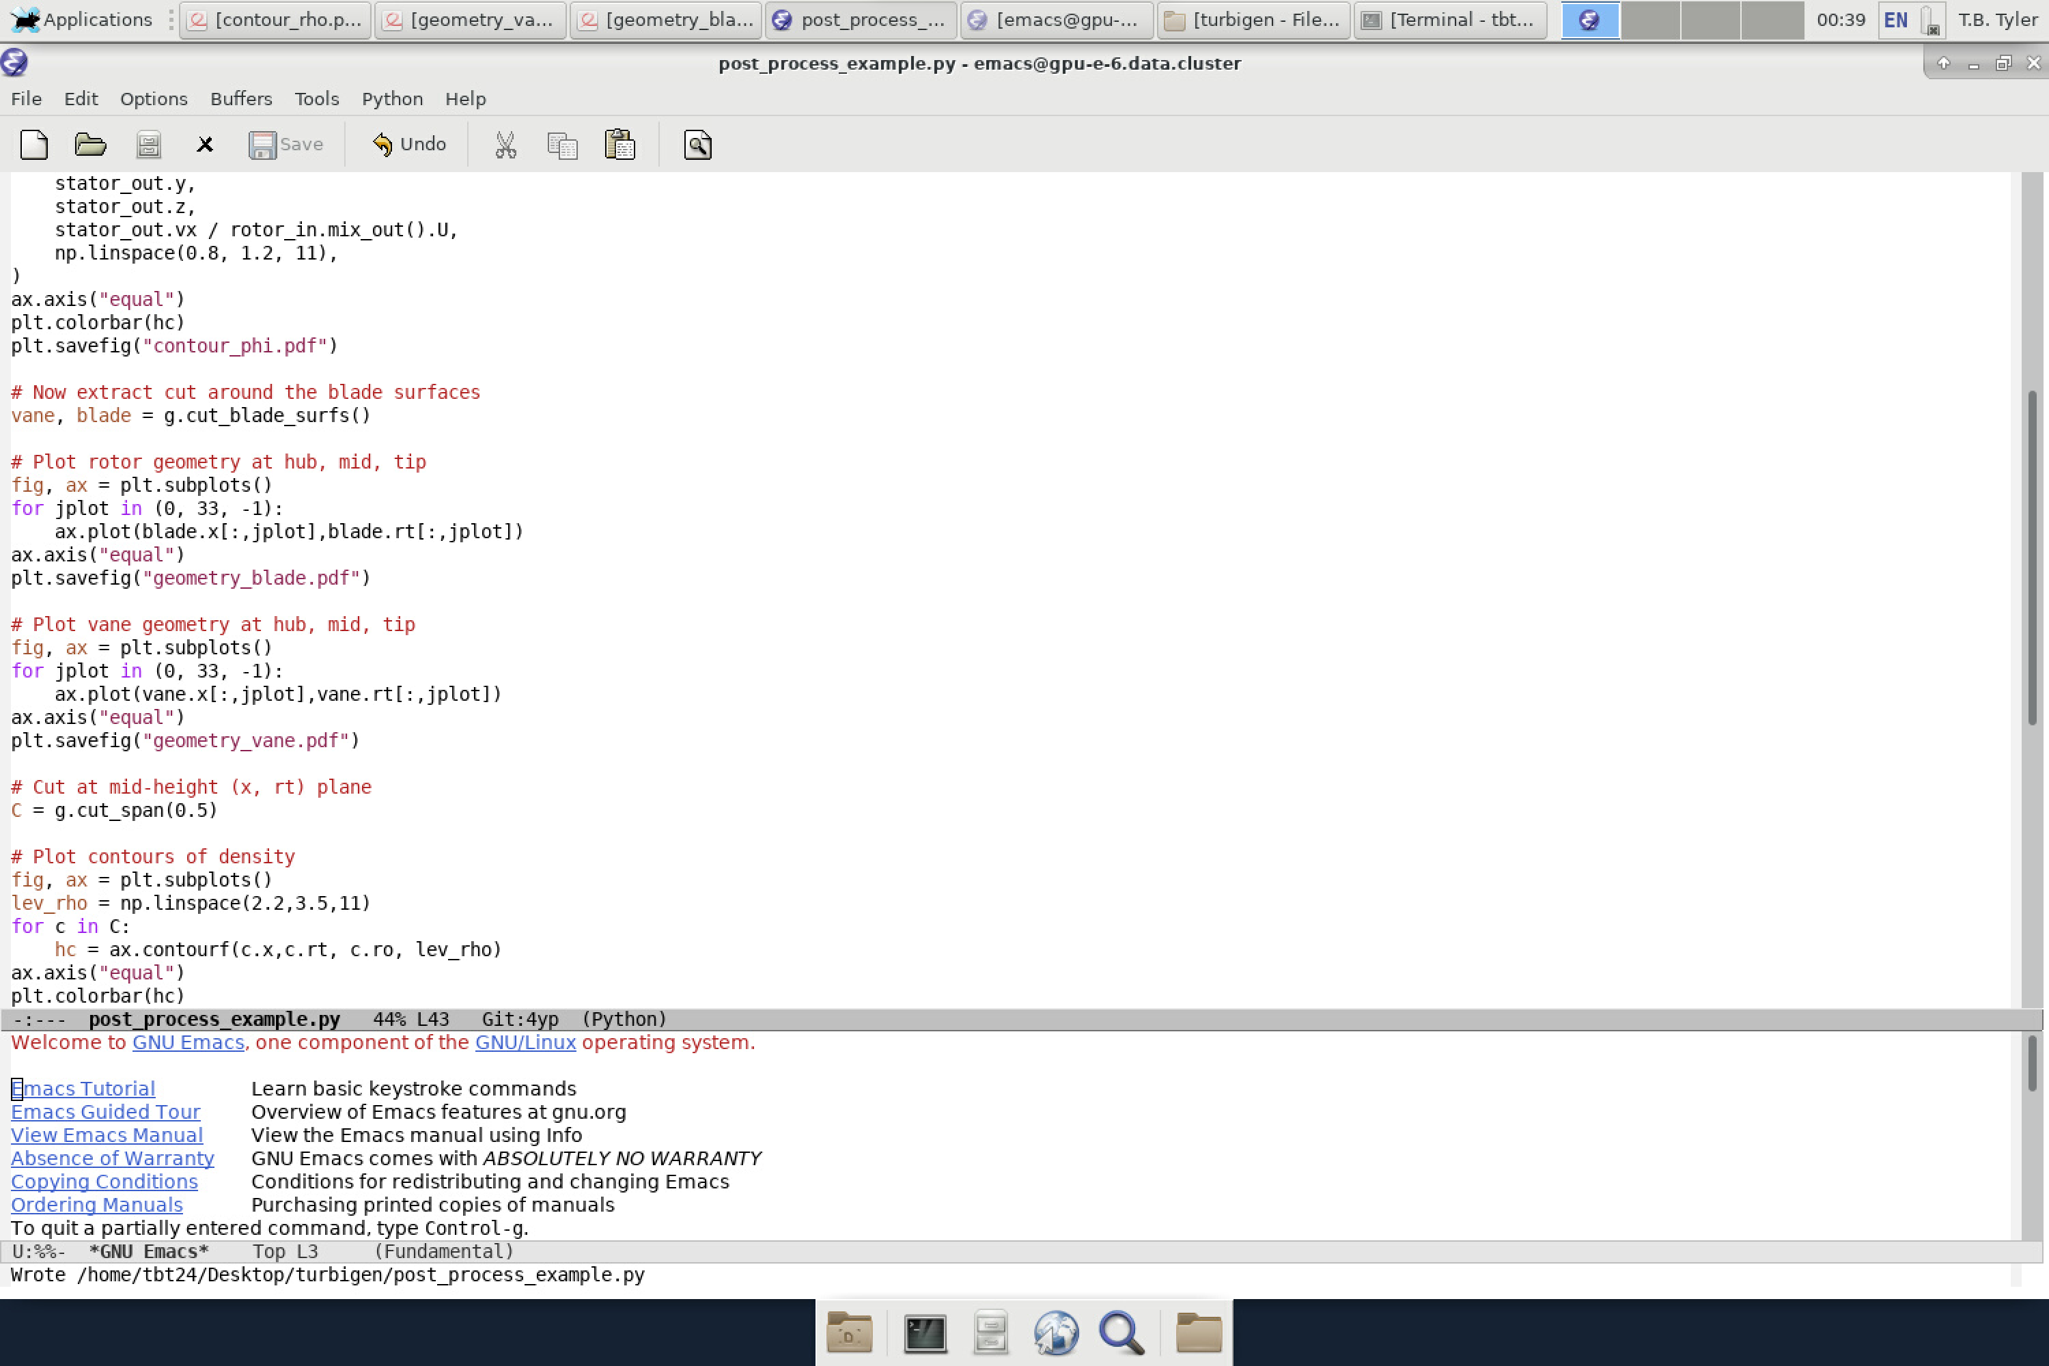
Easier way of coding in UI?

Slide 36
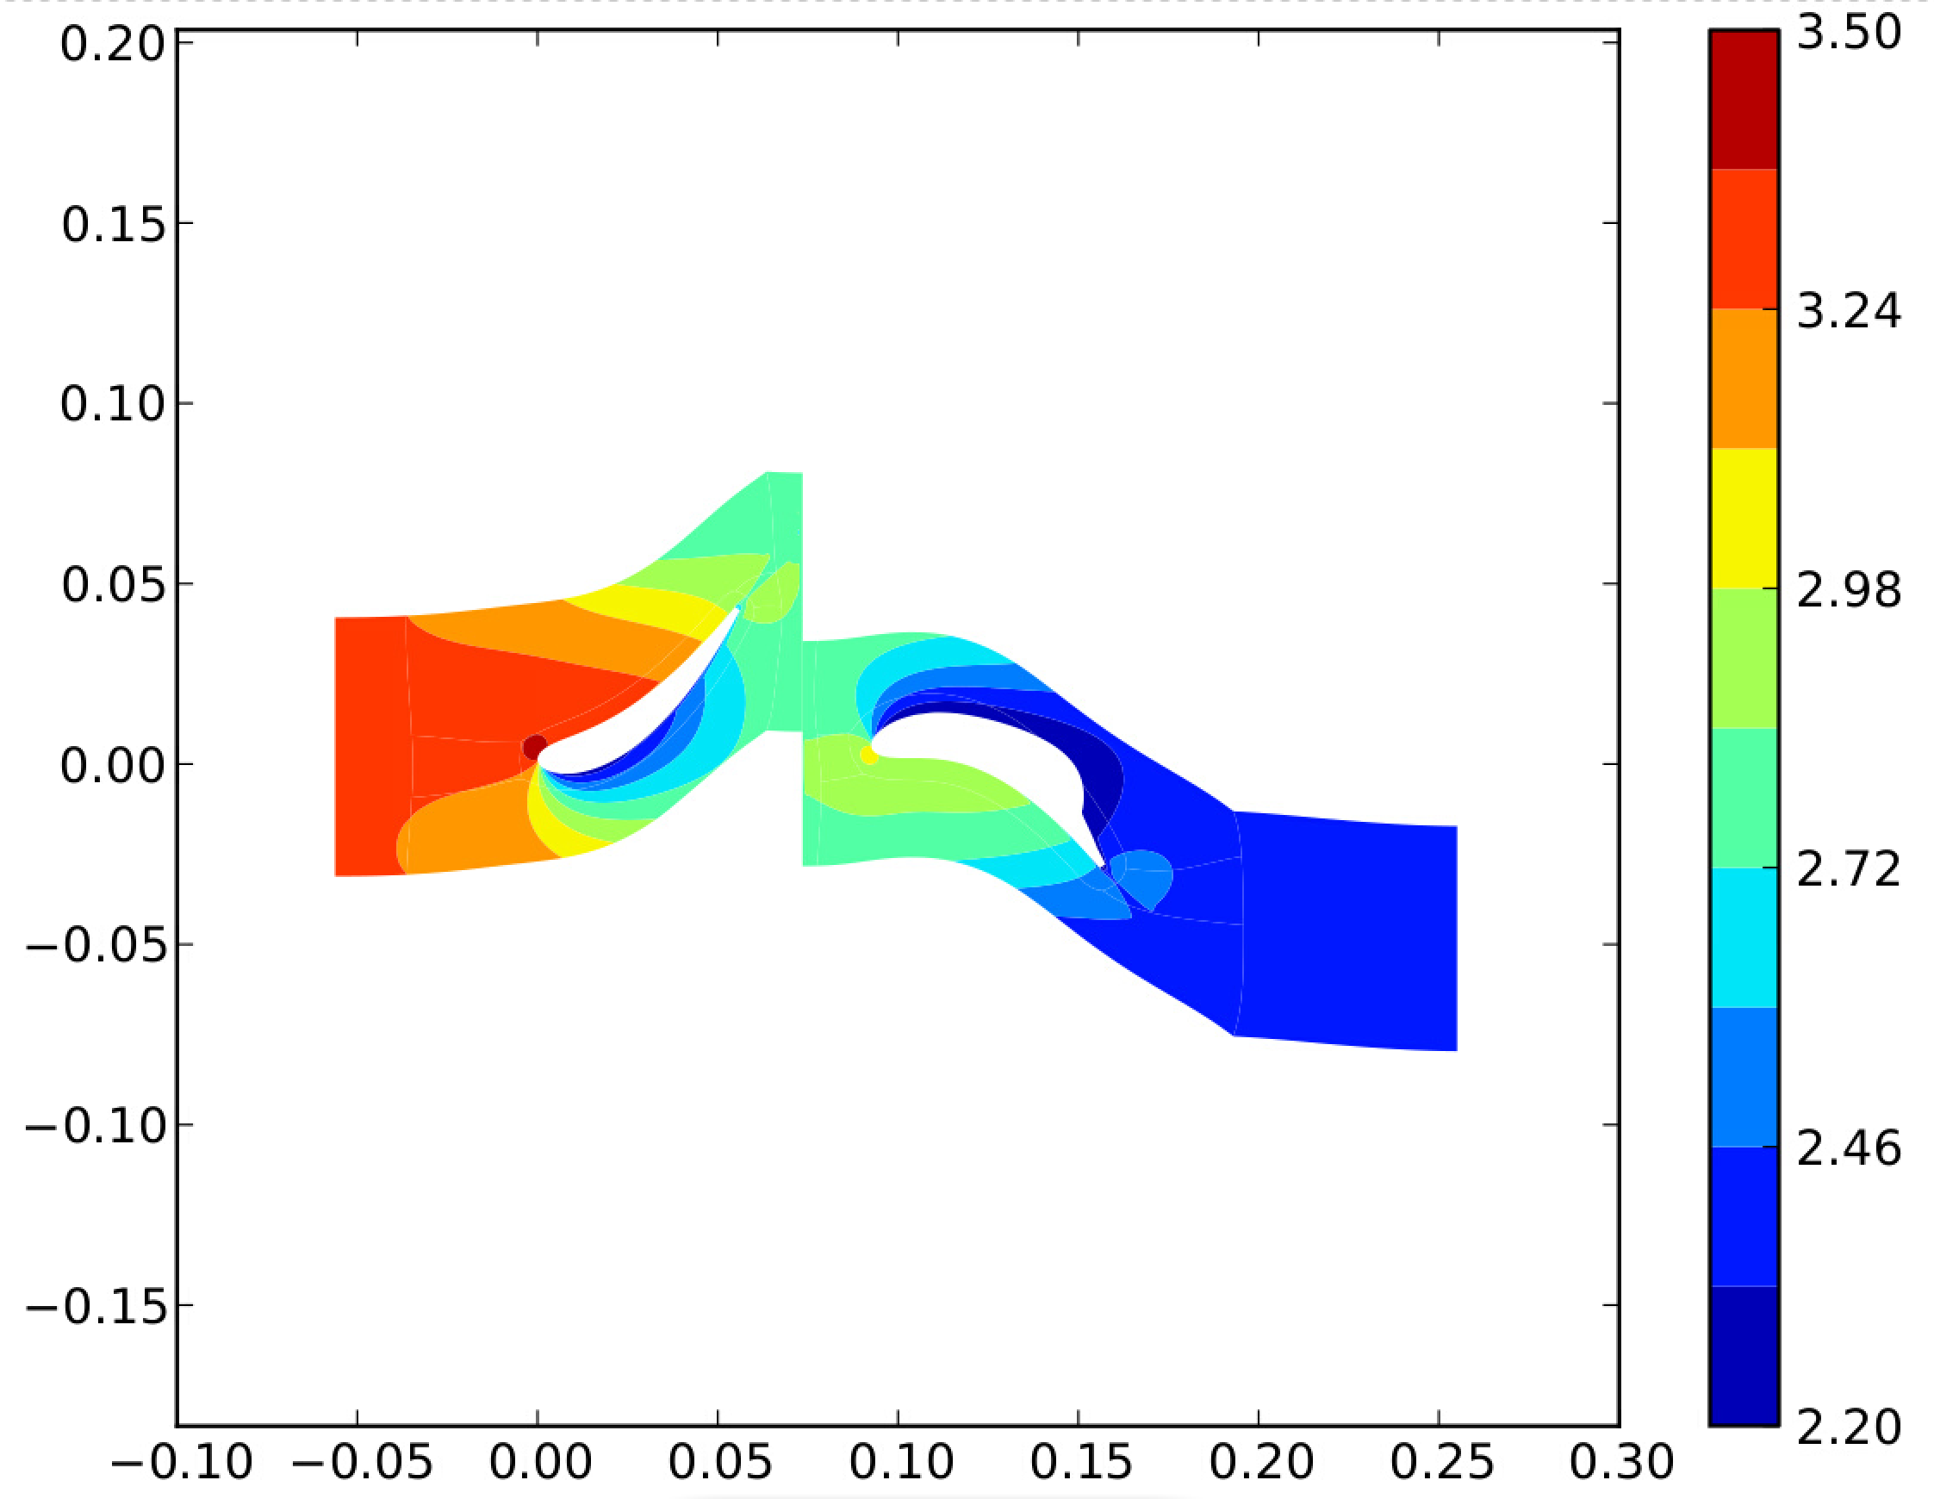
Odd shape of blade? Density plot

Slide 37
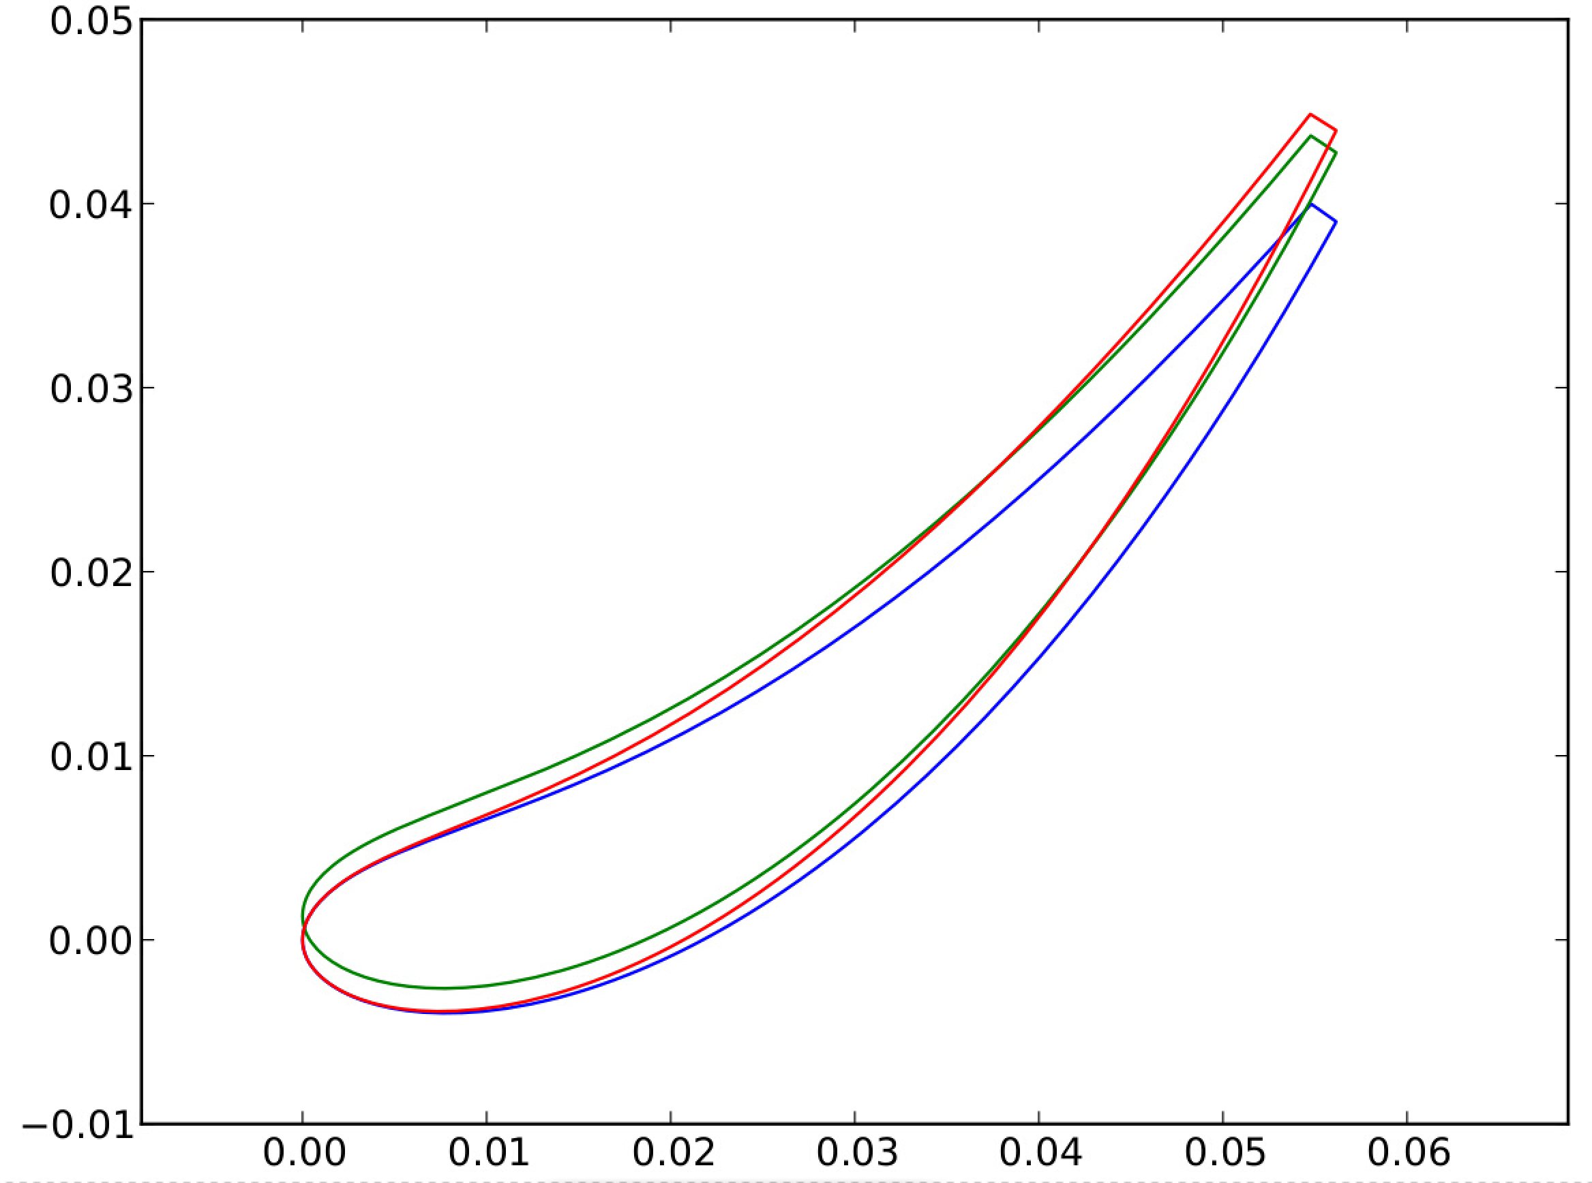
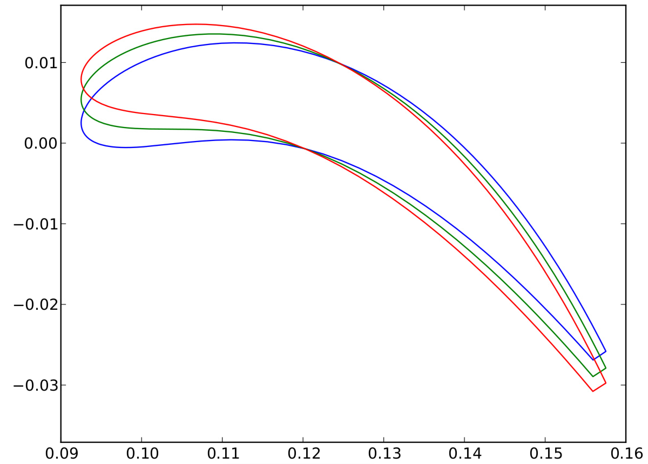
Geometries
Vane
Blade

Slide 38
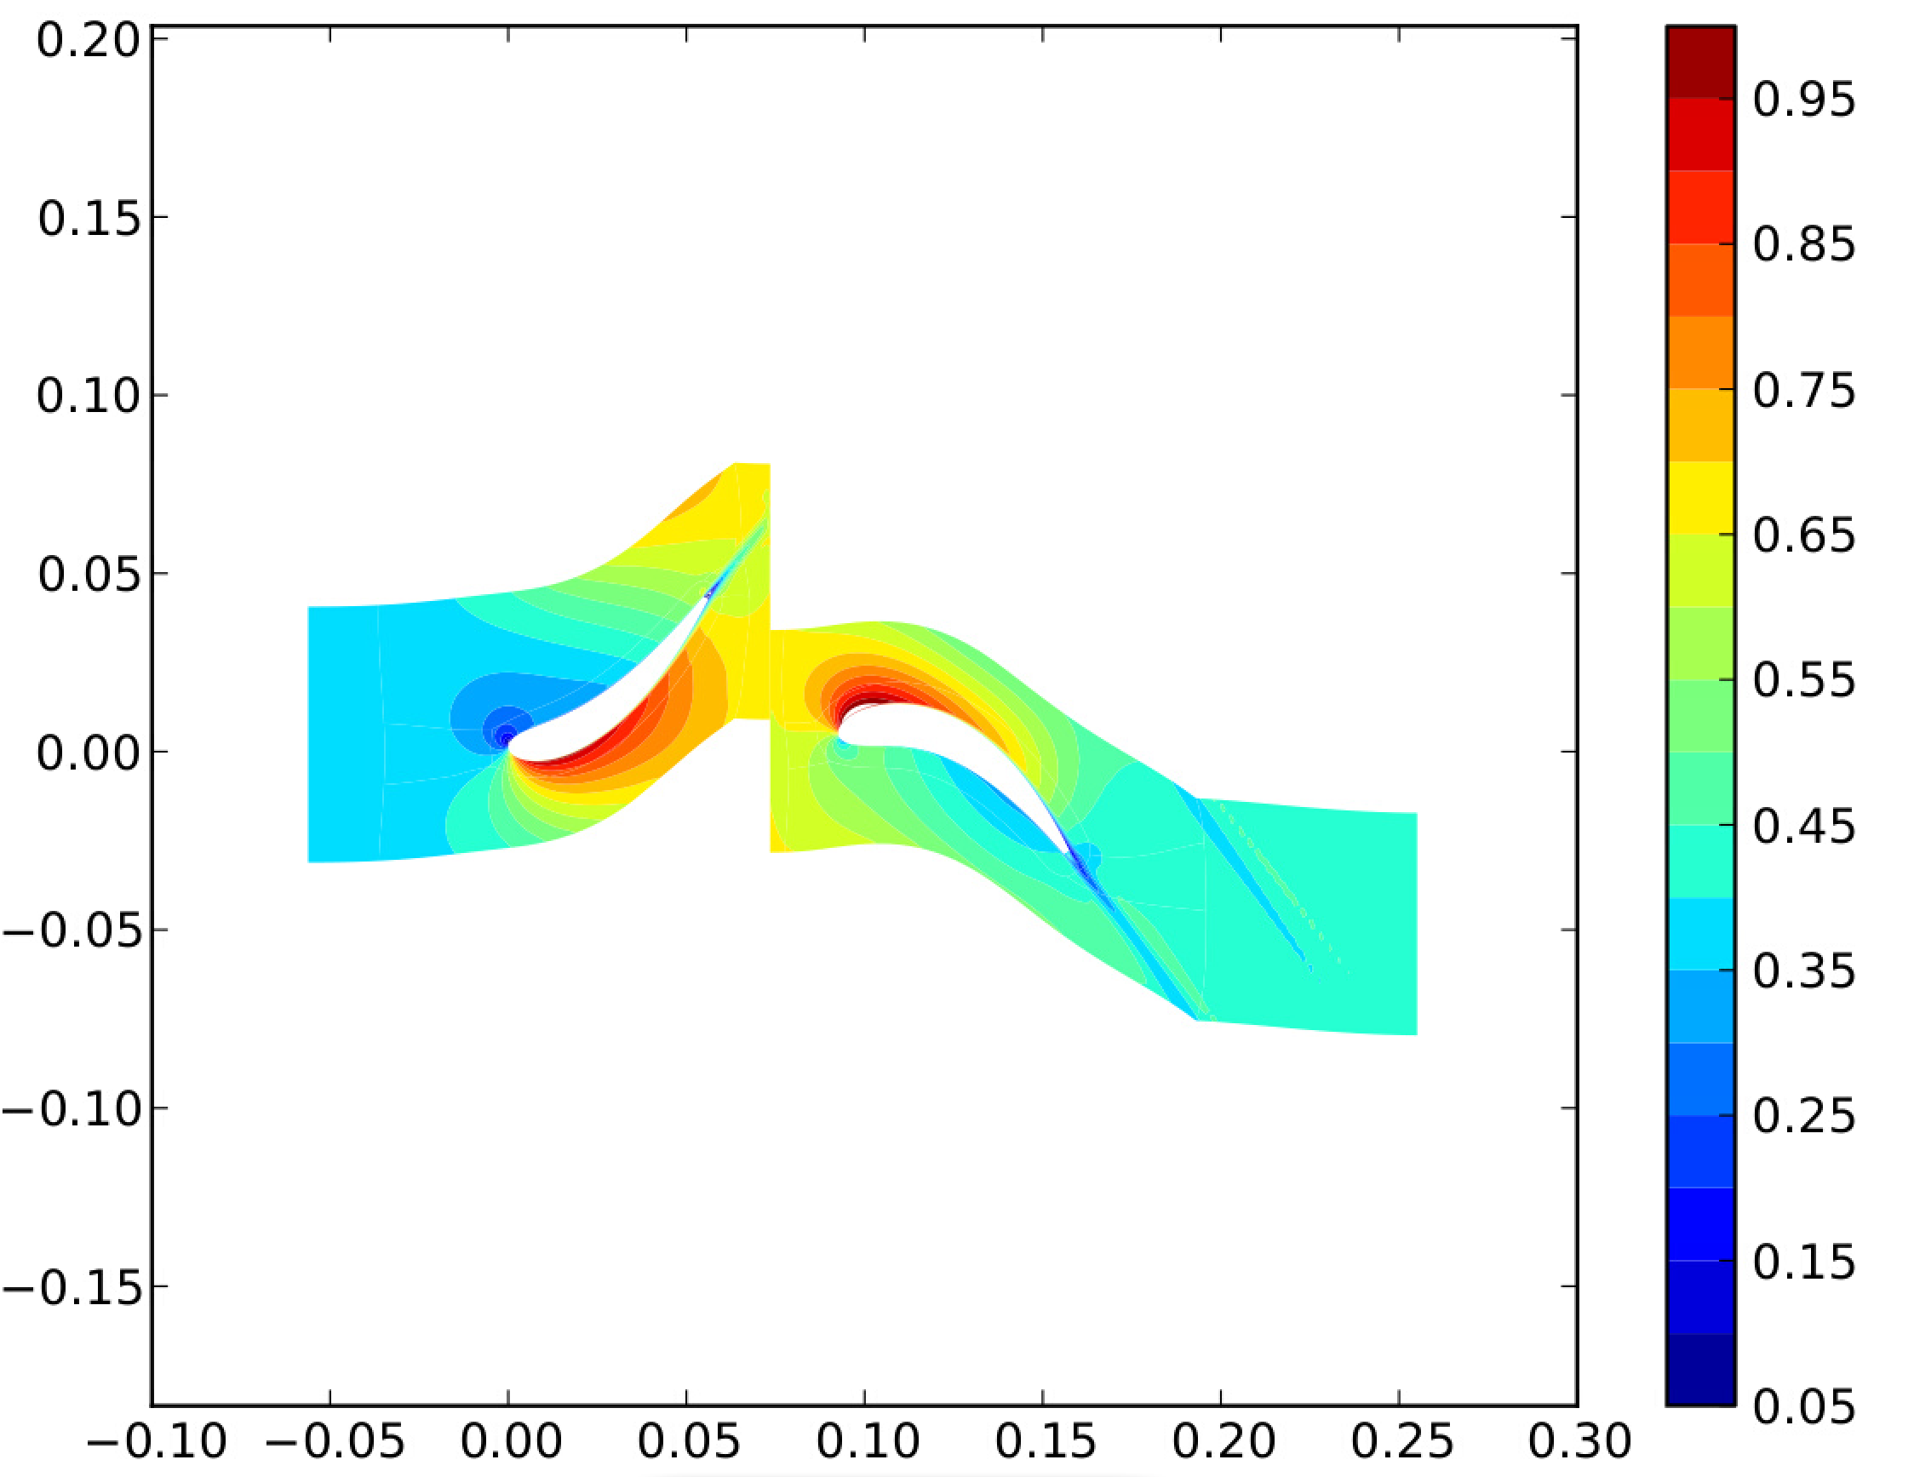
Mach number

Slide 39
Week 5 M
Running more simulations and deciding what variables need to be explored

Slide 40
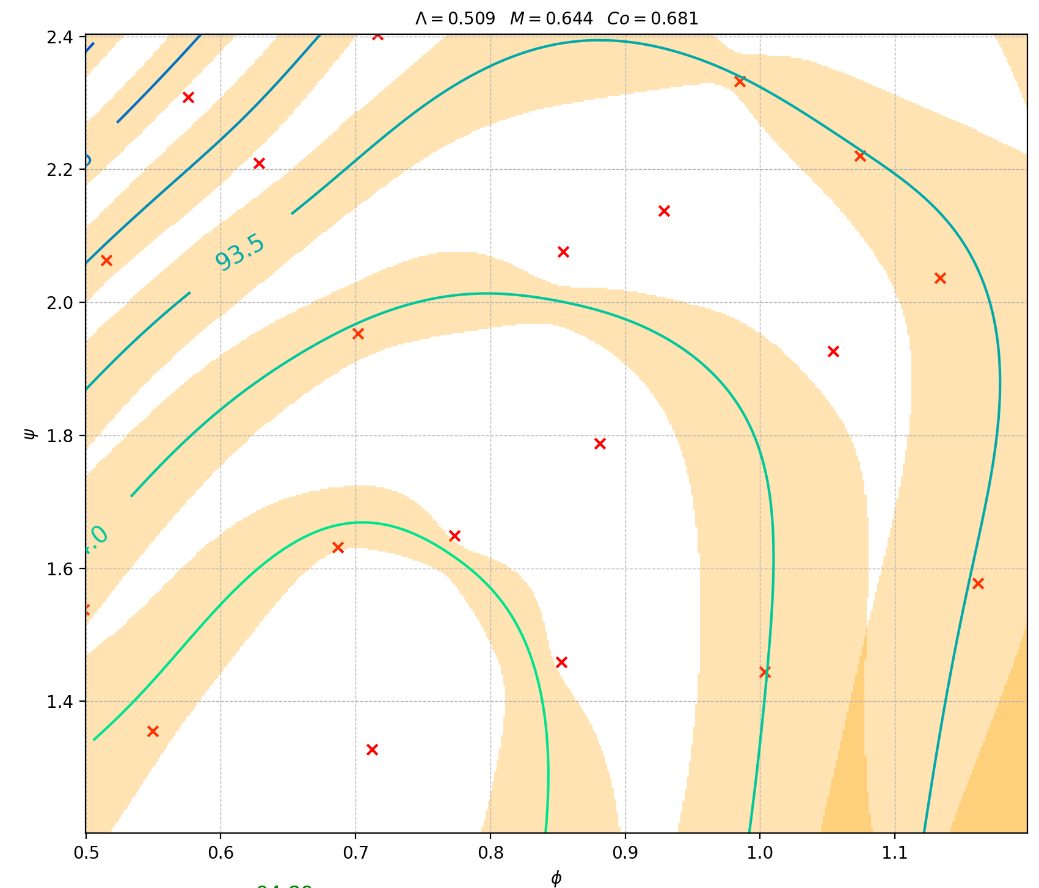
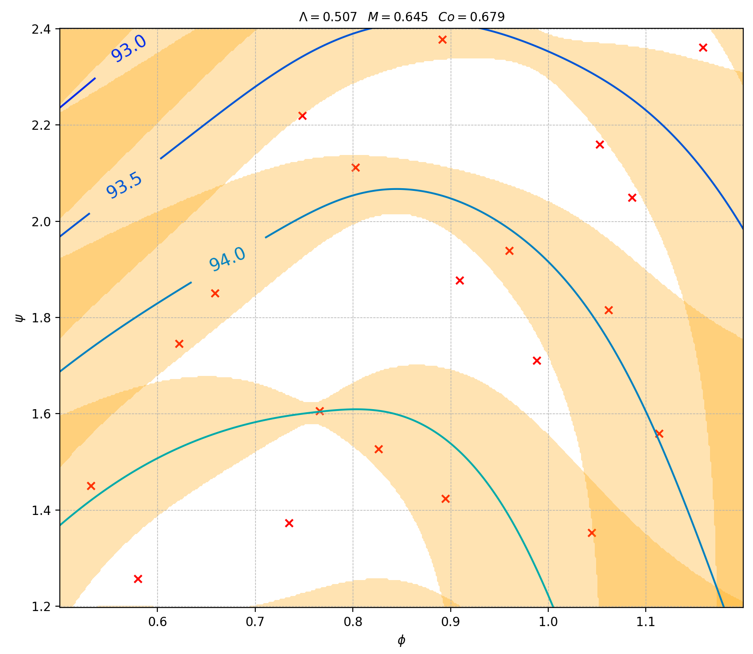

Comparison of $φ$versus$ψ$ plots (95% CI)
Data-C (26 points)
Data-F (27 points)

Slide 41
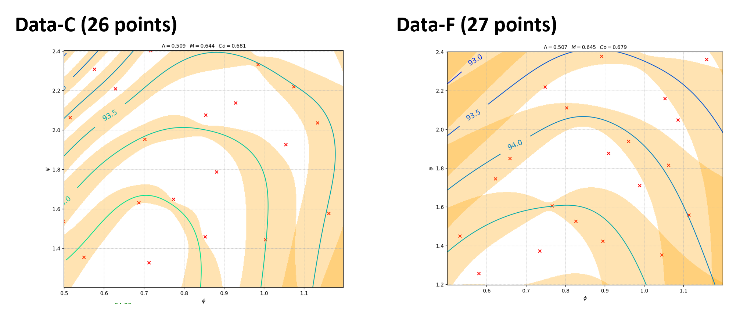
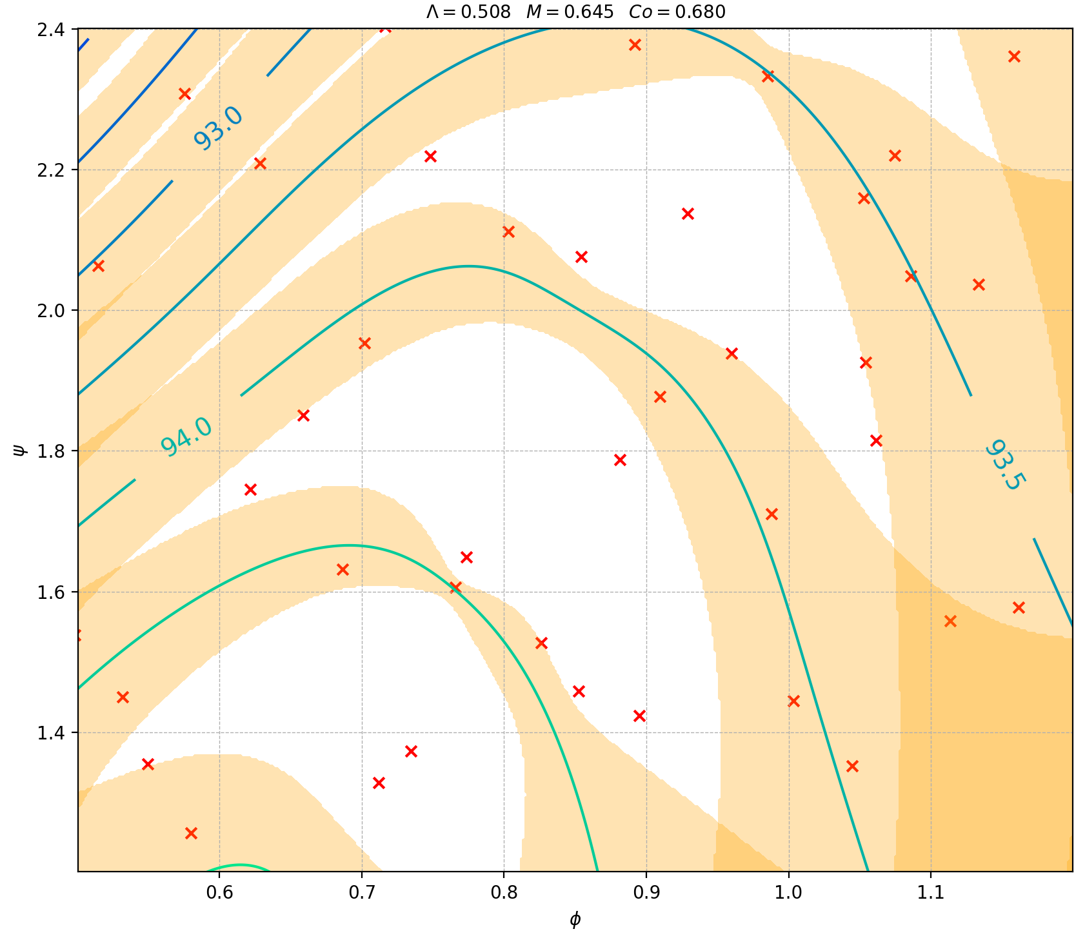
Combined dataset (95% CI)
53 data points

Slide 42


Effect of noise on pseudo-2D data
No noise
Noise=1e-7
Noise=1e-6

Slide 43

Possible reasons for large CI:
Data is not actually 2D, but 5D as $M$, $C_{o}$ and $Λ$ not kept fixed by software
Not enough data yet (53 points so far for this case)

Slide 44



Force constant values for $M$, $C_{o}$ and $Λ$
Edited python code with new function fix_vars
This turns 5D regression problem into 2D problem, fixing values for $M$, $C_{o}$ and $Λ$ .
The results are not accurate, as values might have been changed a lot to be forced, but give an indication of number of data points required for 2D

Slide 45




Force constant values for $M$, $C_{o}$ and $Λ$ (no noise) (95% CI)
Data-C
Data-F
Data-C + Data-F
Seems like we need to add noise

Slide 46


Effect of noise on fully-2D data
No noise
Noise=1e-7
Noise=1e-6
Odd characteristic has been fixed with noise

Slide 47
Presentation (24th Nov, 13:30)
Speak 10 mins
Questions 5 mins
Bring USB with presentation on
Calculate slides/minute
As well as answering questions, welcome suggestions

Slide 48
Presentation (24th Nov, 13:30)
In making the presentation you will be expected to give clear expression to:
the aims of the project and their significance;
the background and context;
your plan of how to achieve the aims;
the progress made so far towards fulfilling the plans.

Slide 49
Planning
5 slides? (2 mins per slide)
Accuracy plot
Smith chart comparison

Slide 50
Week 6 M
Improved workflow with the HPC, post_process.py and collate_results.py. Added optimisation over smoothness parameter ‘nu’. Cleaned up the colours of plots.

Slide 51


New functions, and lots of improvements to dd_turbine_design.py
Optimisation of noise and smoothness added

Slide 52


Colours of contours improved

Slide 53

Can now compare across a grid more easily

Slide 54
Week 7 M
Worked on presentation. Implemented pre-processing. Tried to use Paraview to visualise data.

Slide 55

Presentation

Slide 56

Improved ability with post-processing

Slide 57

Pre-processing

Slide 58
Week 1 L
Lots of improvements to the dd_turb_design.py code. Begun work on extracting extra parameters from ‘Results’ HPC folder. Generated 4D data.

Slide 59
Code improvements
Big code overhaul such that fitting is both general in terms of input parameters and dimensions.
Kernel is no longer an input but fixed, with its parameters in __init__. This makes the code more accessible for someone unfamiliar with GPR.
Removed redundant code and streamlined inefficiencies.
‘runid’ function is truly implemented. Before was just RNG.

Slide 60

Extracting extra parameters

Slide 61

4D data

Slide 62
Week 2 L
Lots of improvements to the main code. Overhauled plotting. Attempts at non-dimensional to dimensional conversion. Extending ‘smaller’ datasets using data within the error margin. New collate results finished. Loss-breakdown started. Begun investigative C₀ with actual data points rather than model

Slide 63
Plotting improvements
plot_grid_vars now works for N-dimensional data.
plot_vars is now general for any input parameter, not just Phi/psi/co etc.
Built framework inside plot_vars to plot two 1D graphs together.
Replaced plot_vars and plot_grid_vars with a new function ‘plot’ which is more intuitive.

Slide 64

Generation of more 4D data points
56 data points
61 data points

Slide 65

Enhancing datasets
Datasets are ‘enhanced’ using data from other datasets that are within 5% of correct values.
E.g. 4D dataset = 67 points, but when ‘enhanced’, this increases to 187 data points. (67 decreases to 61 when outliers removed)

Slide 66


Enhancing datasets
N=61
N=187

Slide 67


Pre-processing
None
‘minmax’

Slide 68
Non-dimensional / dimensional conversion
New ‘collate_results.py’ HPC function created to extract 20 parameters from CFD. These are now read in main code.
New ‘extract_more_data.py’ HPC function created to update old datasets with additional data.
This is filtered by a new function called ‘drop_columns’
Extra_non_dim function created
Dim_to_non_dim function created

Slide 69


Loss-breakdown
Loss breakdown started:
$$\overline{p_{0}}=\frac{\int_{r_{1}}^{r_{2}}{ρV_{x}{ p}_{0} dA}}{\int_{r_{1}}^{r_{2}}{ρV_{x} dA}}$$
Computes $\overline{p_{0}}$ for low, medium and high streamtubes.

Slide 70

Co curve variation with phi

Slide 71

Co curve variation with psi

Slide 72
Week 3 L

Slide 73


Slide 74


Slide 75


Slide 76


Slide 77


Slide 78
Realistically bounds on Co,opt from 0.55 to 0.7
Previously generated points from 0.4 to 0.8 so can reduce this

Slide 79


Slide 80
Reduce phi bounds from 0.5-1.2 to 0.5 to 1.0 based on phi opt plot
Now go back and redo Co evaluation – co,opt limits unchanged

Slide 81


Slide 82


Slide 83
Reduce psi bounds from 1.0-2.4 to 1.0-2.0
Final bounds are:
Phi: (0.4-1.0)
Psi: (1.0-2.0)
M2: (0.5-0.85)
Co: (0.55-0.7)

Slide 84


Slide 85
Reduce M2 bounds from 0.5-0.95 to 0.5-0.85

